Slide 1
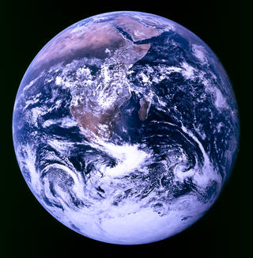

MYP9 - Unit 6
Notes:
New unit. Earth is “home sweet home” to us and to all other living organisms. Initially, for this unit we will focus on the concept of home for animals.

Slide 2
Match these up
KEYWORD | DEFINITION
population | an individual living thing.
organism | a group of populations living and interacting with each other in an area.
ecosystem | a group of organisms of the same species who live in the same area at the same time
community | all the environments on Earth that support life.
biosphere | a community and its abiotic environment.

Slide 3
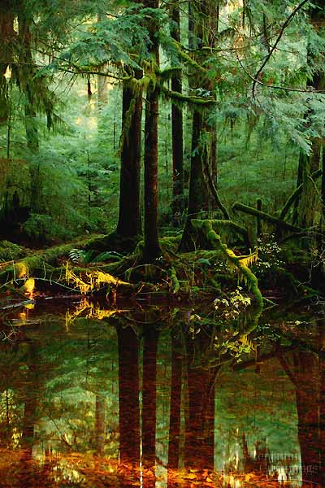
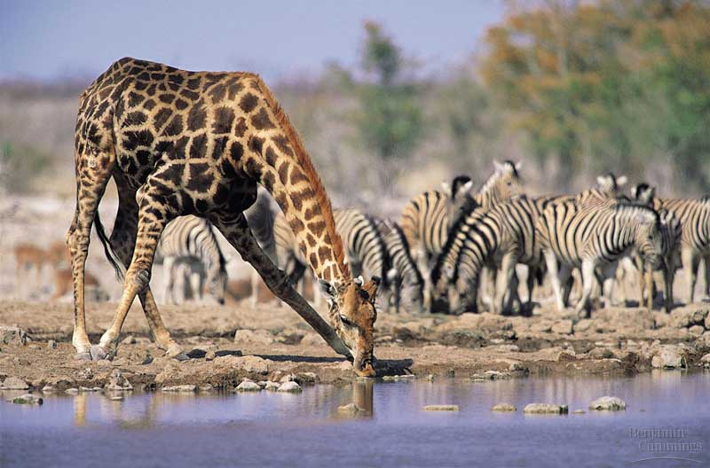
Elements of an ecosystem
Biotic factors
  All living and dead organisms as well as parts of organisms
Abiotic factors
  All non-living elements: soil, rock, temperature, moisture, sunlight

Slide 4
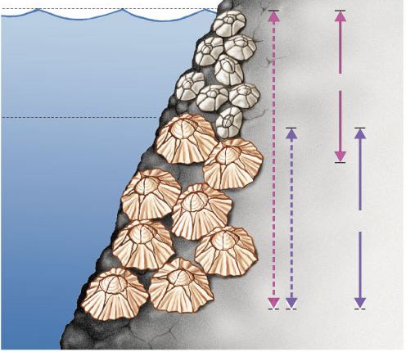
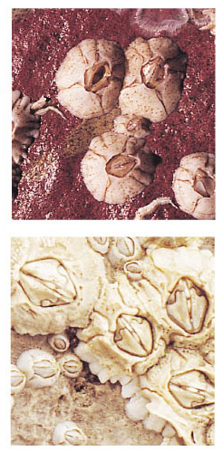
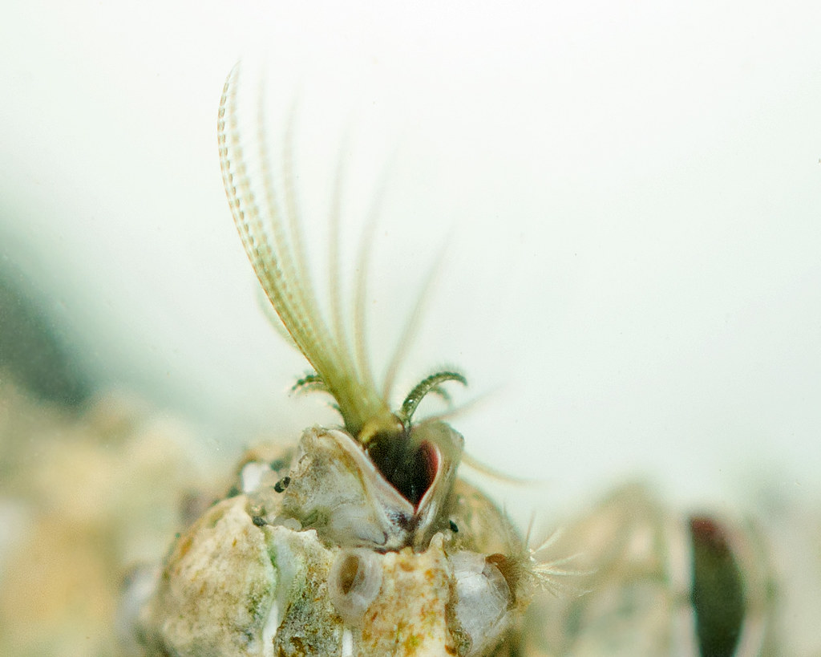
Habitat vs. Niche
habitat = address (where you live)
niche = job (the role you play)
An organism´s habitat is the location where it lives
An organism’s niche is its ecological role
  habitat = address vs. niche = job
  Niche examples: (1) a garden spider is a predator that hunts for prey among plants, (2) an oak tree grows to dominate a forest canopy, turning sunlight into food.
Species 1
High tide
Chthamalus sp.
Low tide
Species 2
Fundamental
niches
Realized
niches
Semibalanus sp.

Slide 5
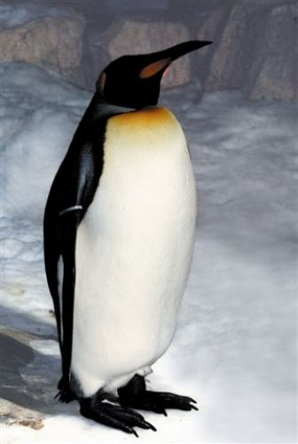
Organism
An individual living thing.
Notes:
Before considering what individual organisms need for survival, the next few slides need to be considered first.

Slide 6
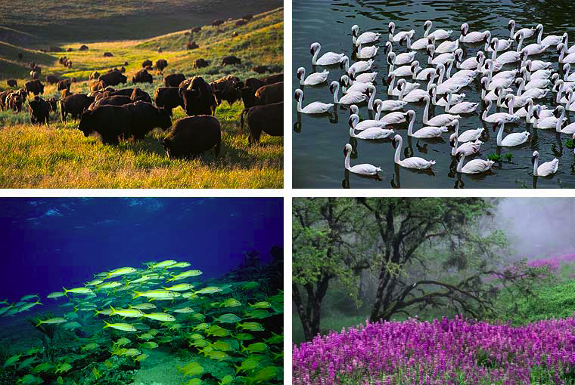
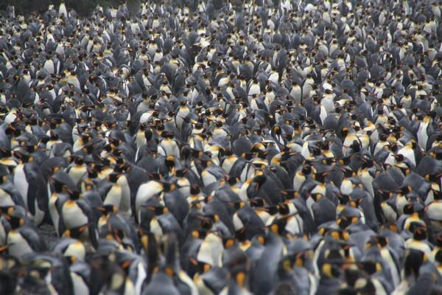
Population
A group of organisms of the same species who live in the same area at the same time.
Notes:
May make link here to the human population?

Slide 7
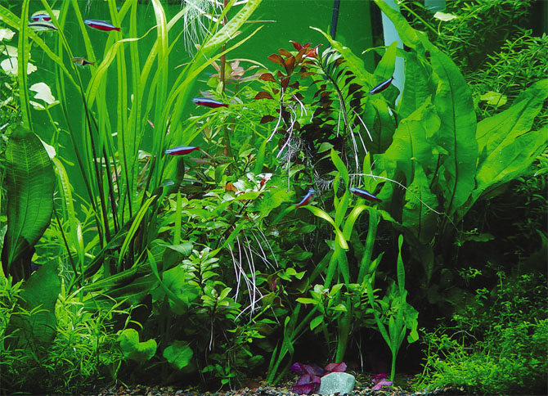
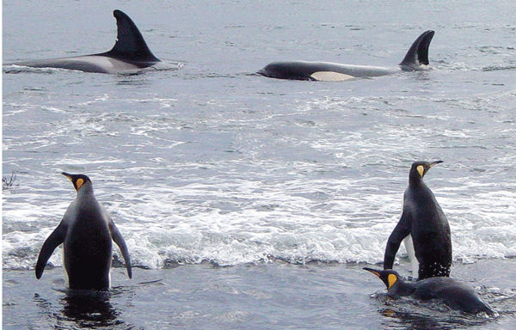
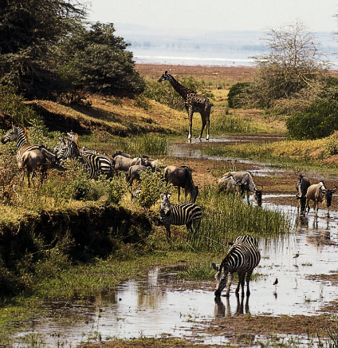
Community
A group of populations living and interacting with each other in an area.
Notes:
Interactions can include predator-prey relationships. Sometimes biology needs to look at the gruesome reality of the struggle for survival!

Slide 8
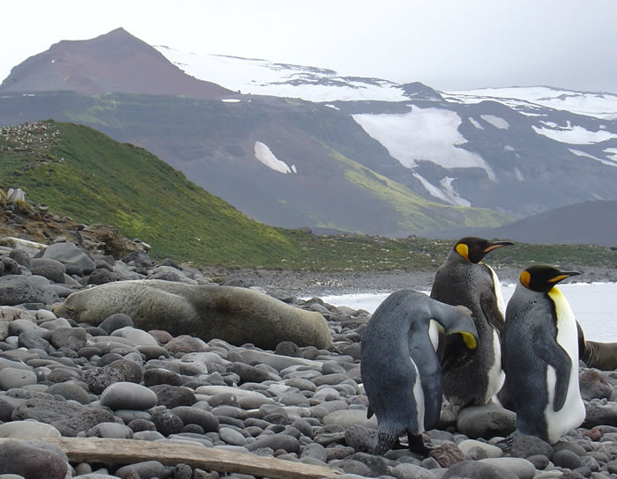
Ecosystem
a community and its abiotic environment.
Ecosystems are self-sustaining
Ecosystems are transformers of energy
& processors of matter
Notes:
Biotic factors include plants, animals, and other organisms. Abiotic factors include rocks, temperature, and humidity.

Slide 9
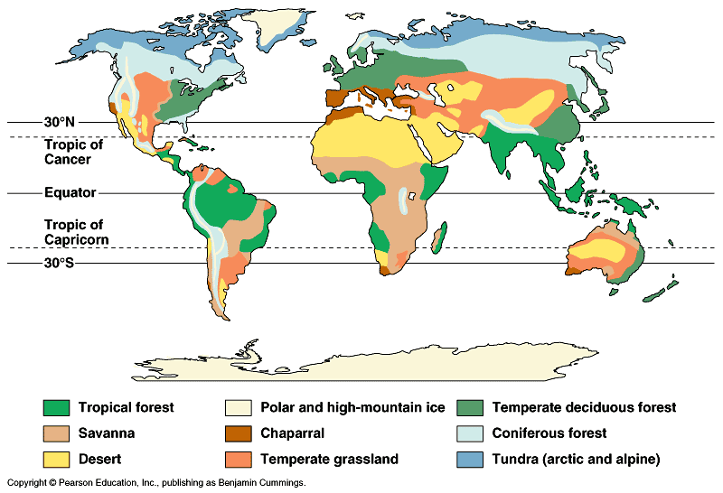
Types of Terrestrial (land) ecosystems

Slide 10
Biosphere
all the environments/ecosystems/biomes on Earth that support life.
Where we can find life – deepest ocean to birds in atmosphere
Notes:
Highlight the definition without specific reference to the various ecosystems as they will feature in the next slide. For the purpose of this unit, we will skip “biomes”.

Slide 11
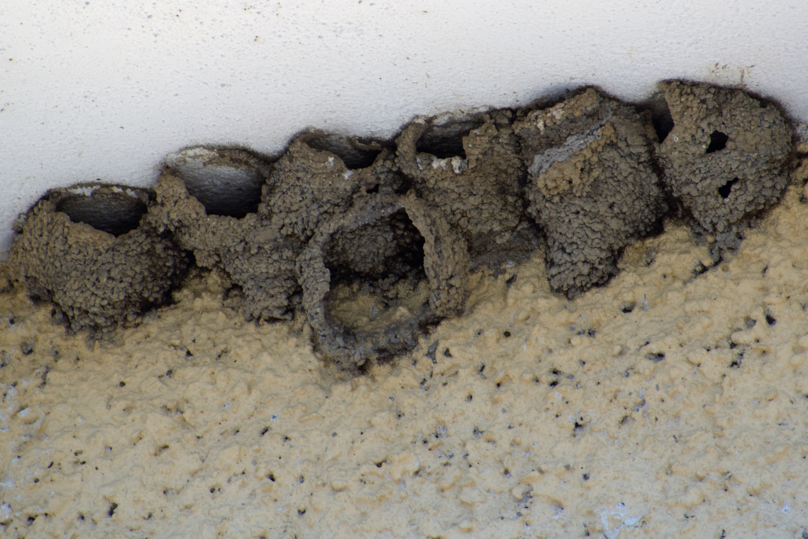
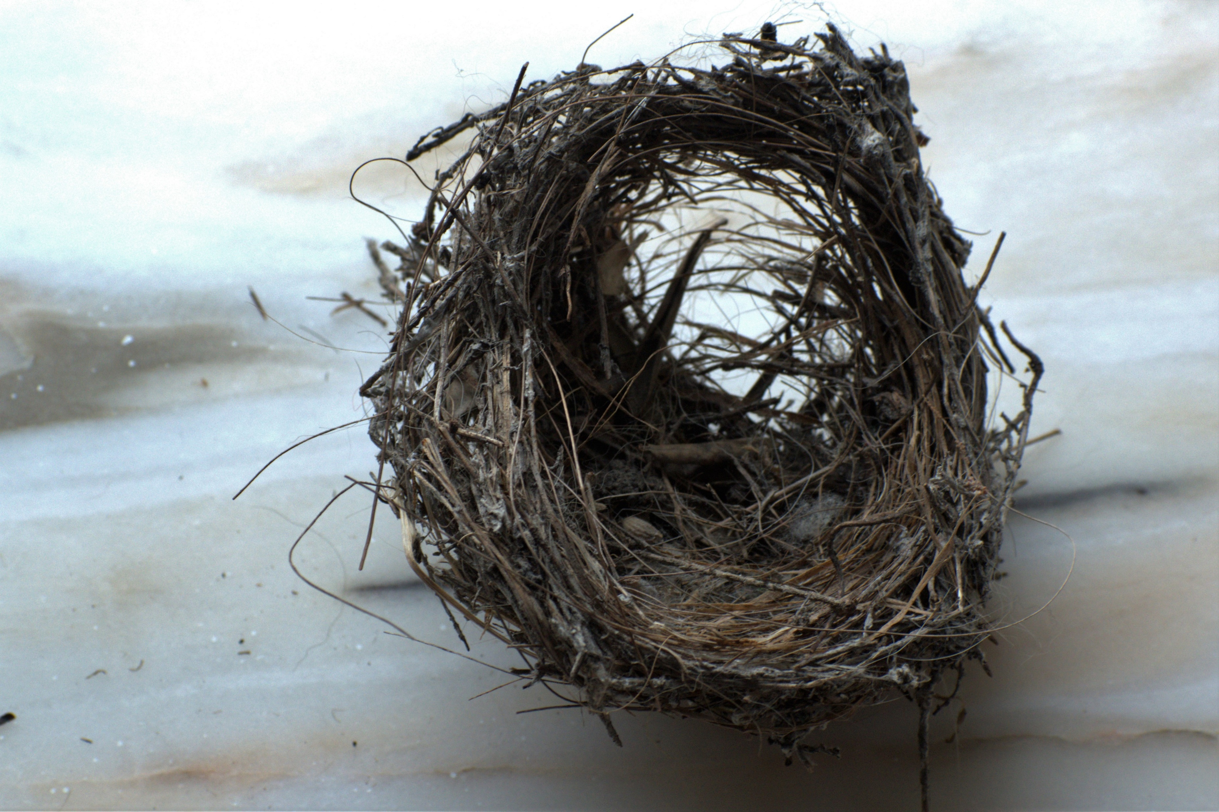
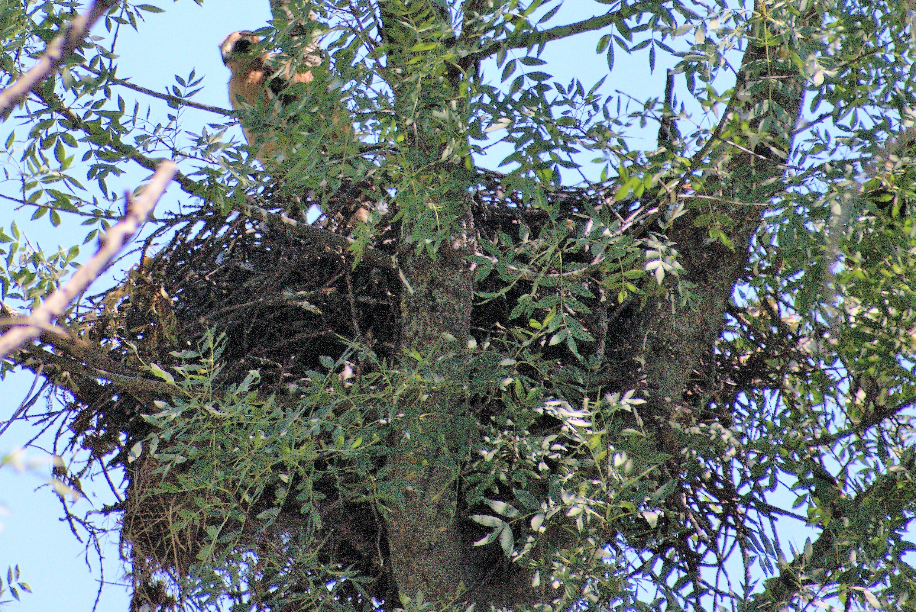
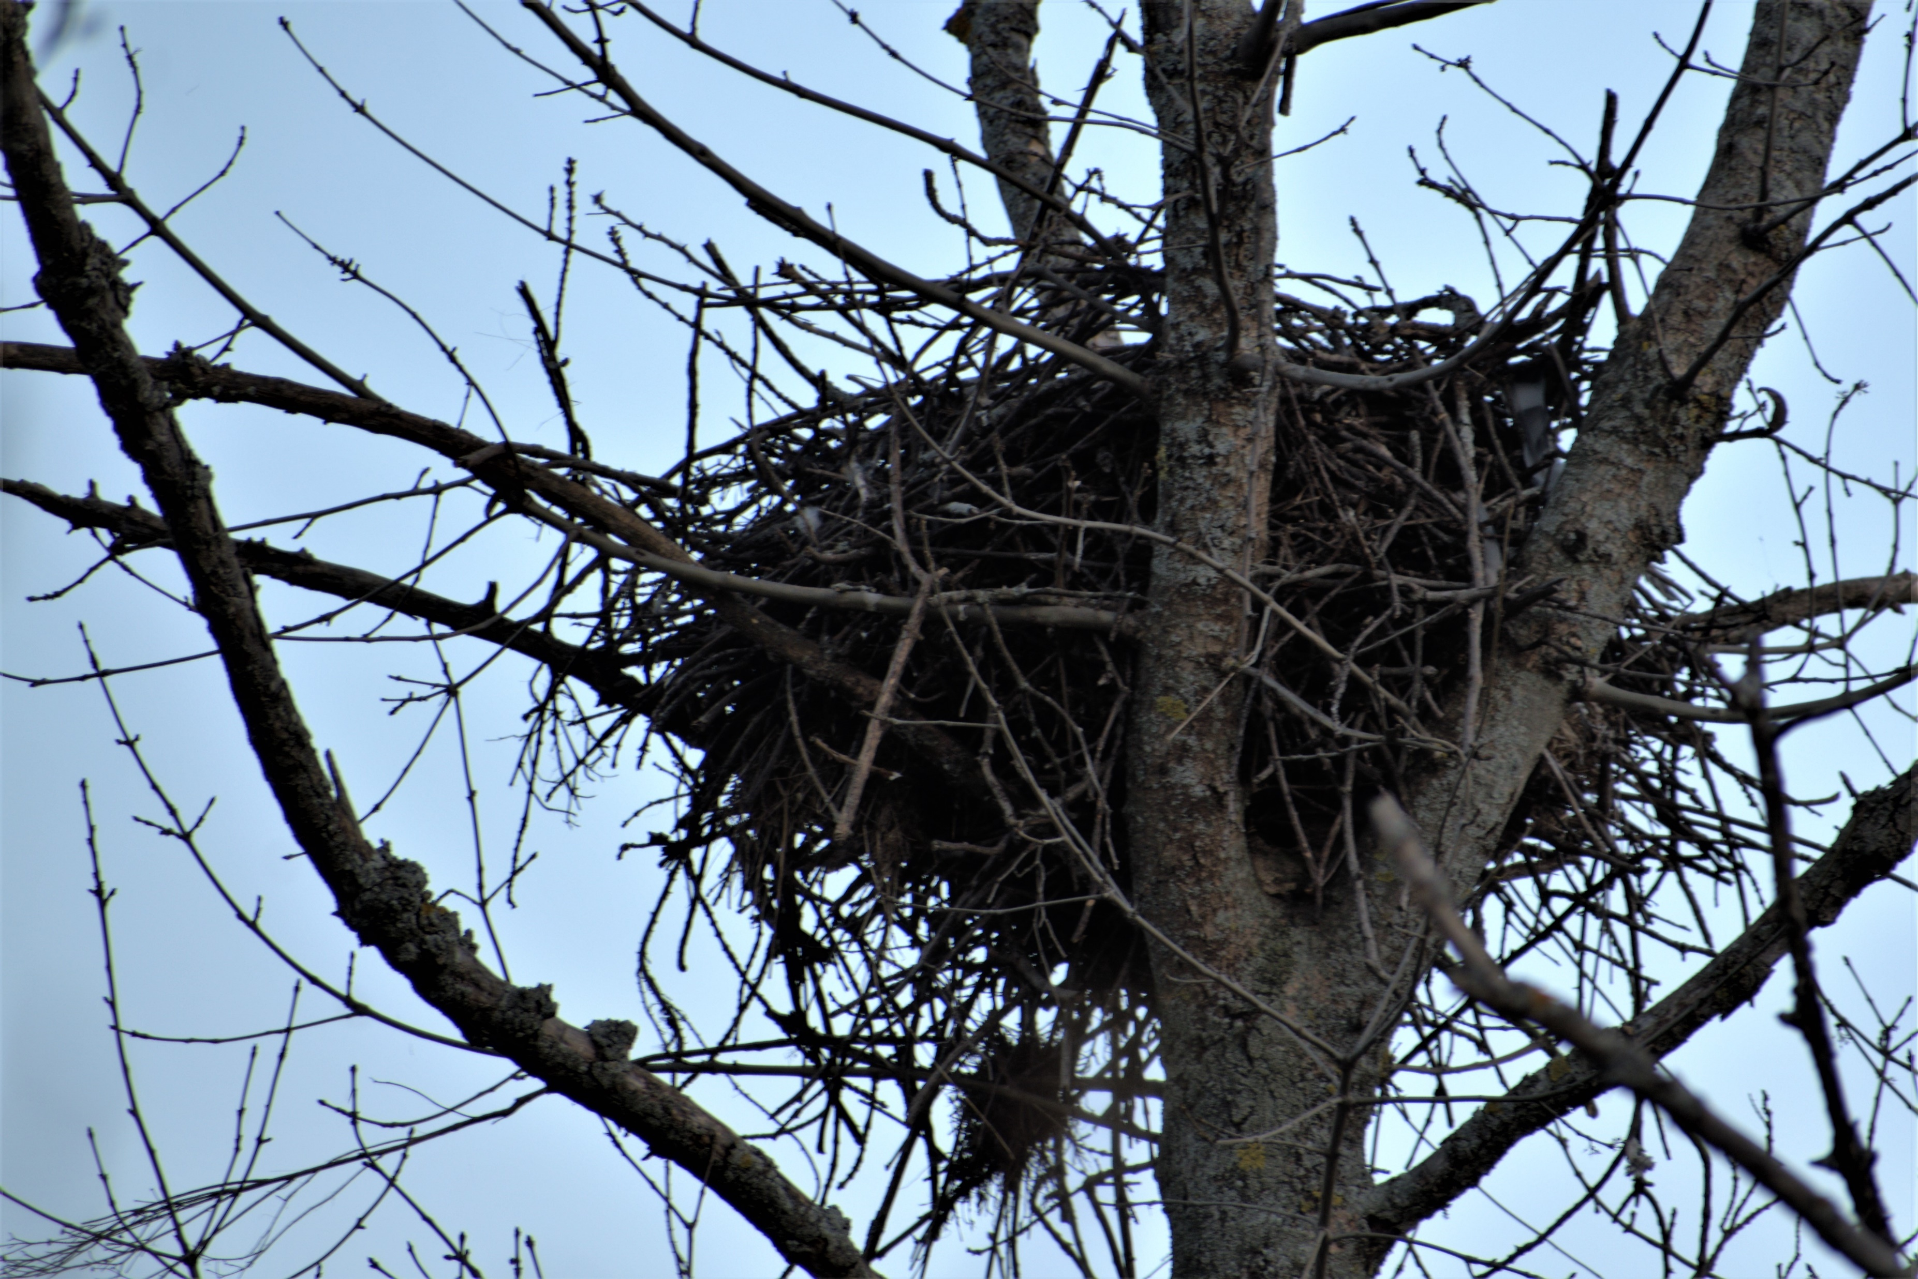
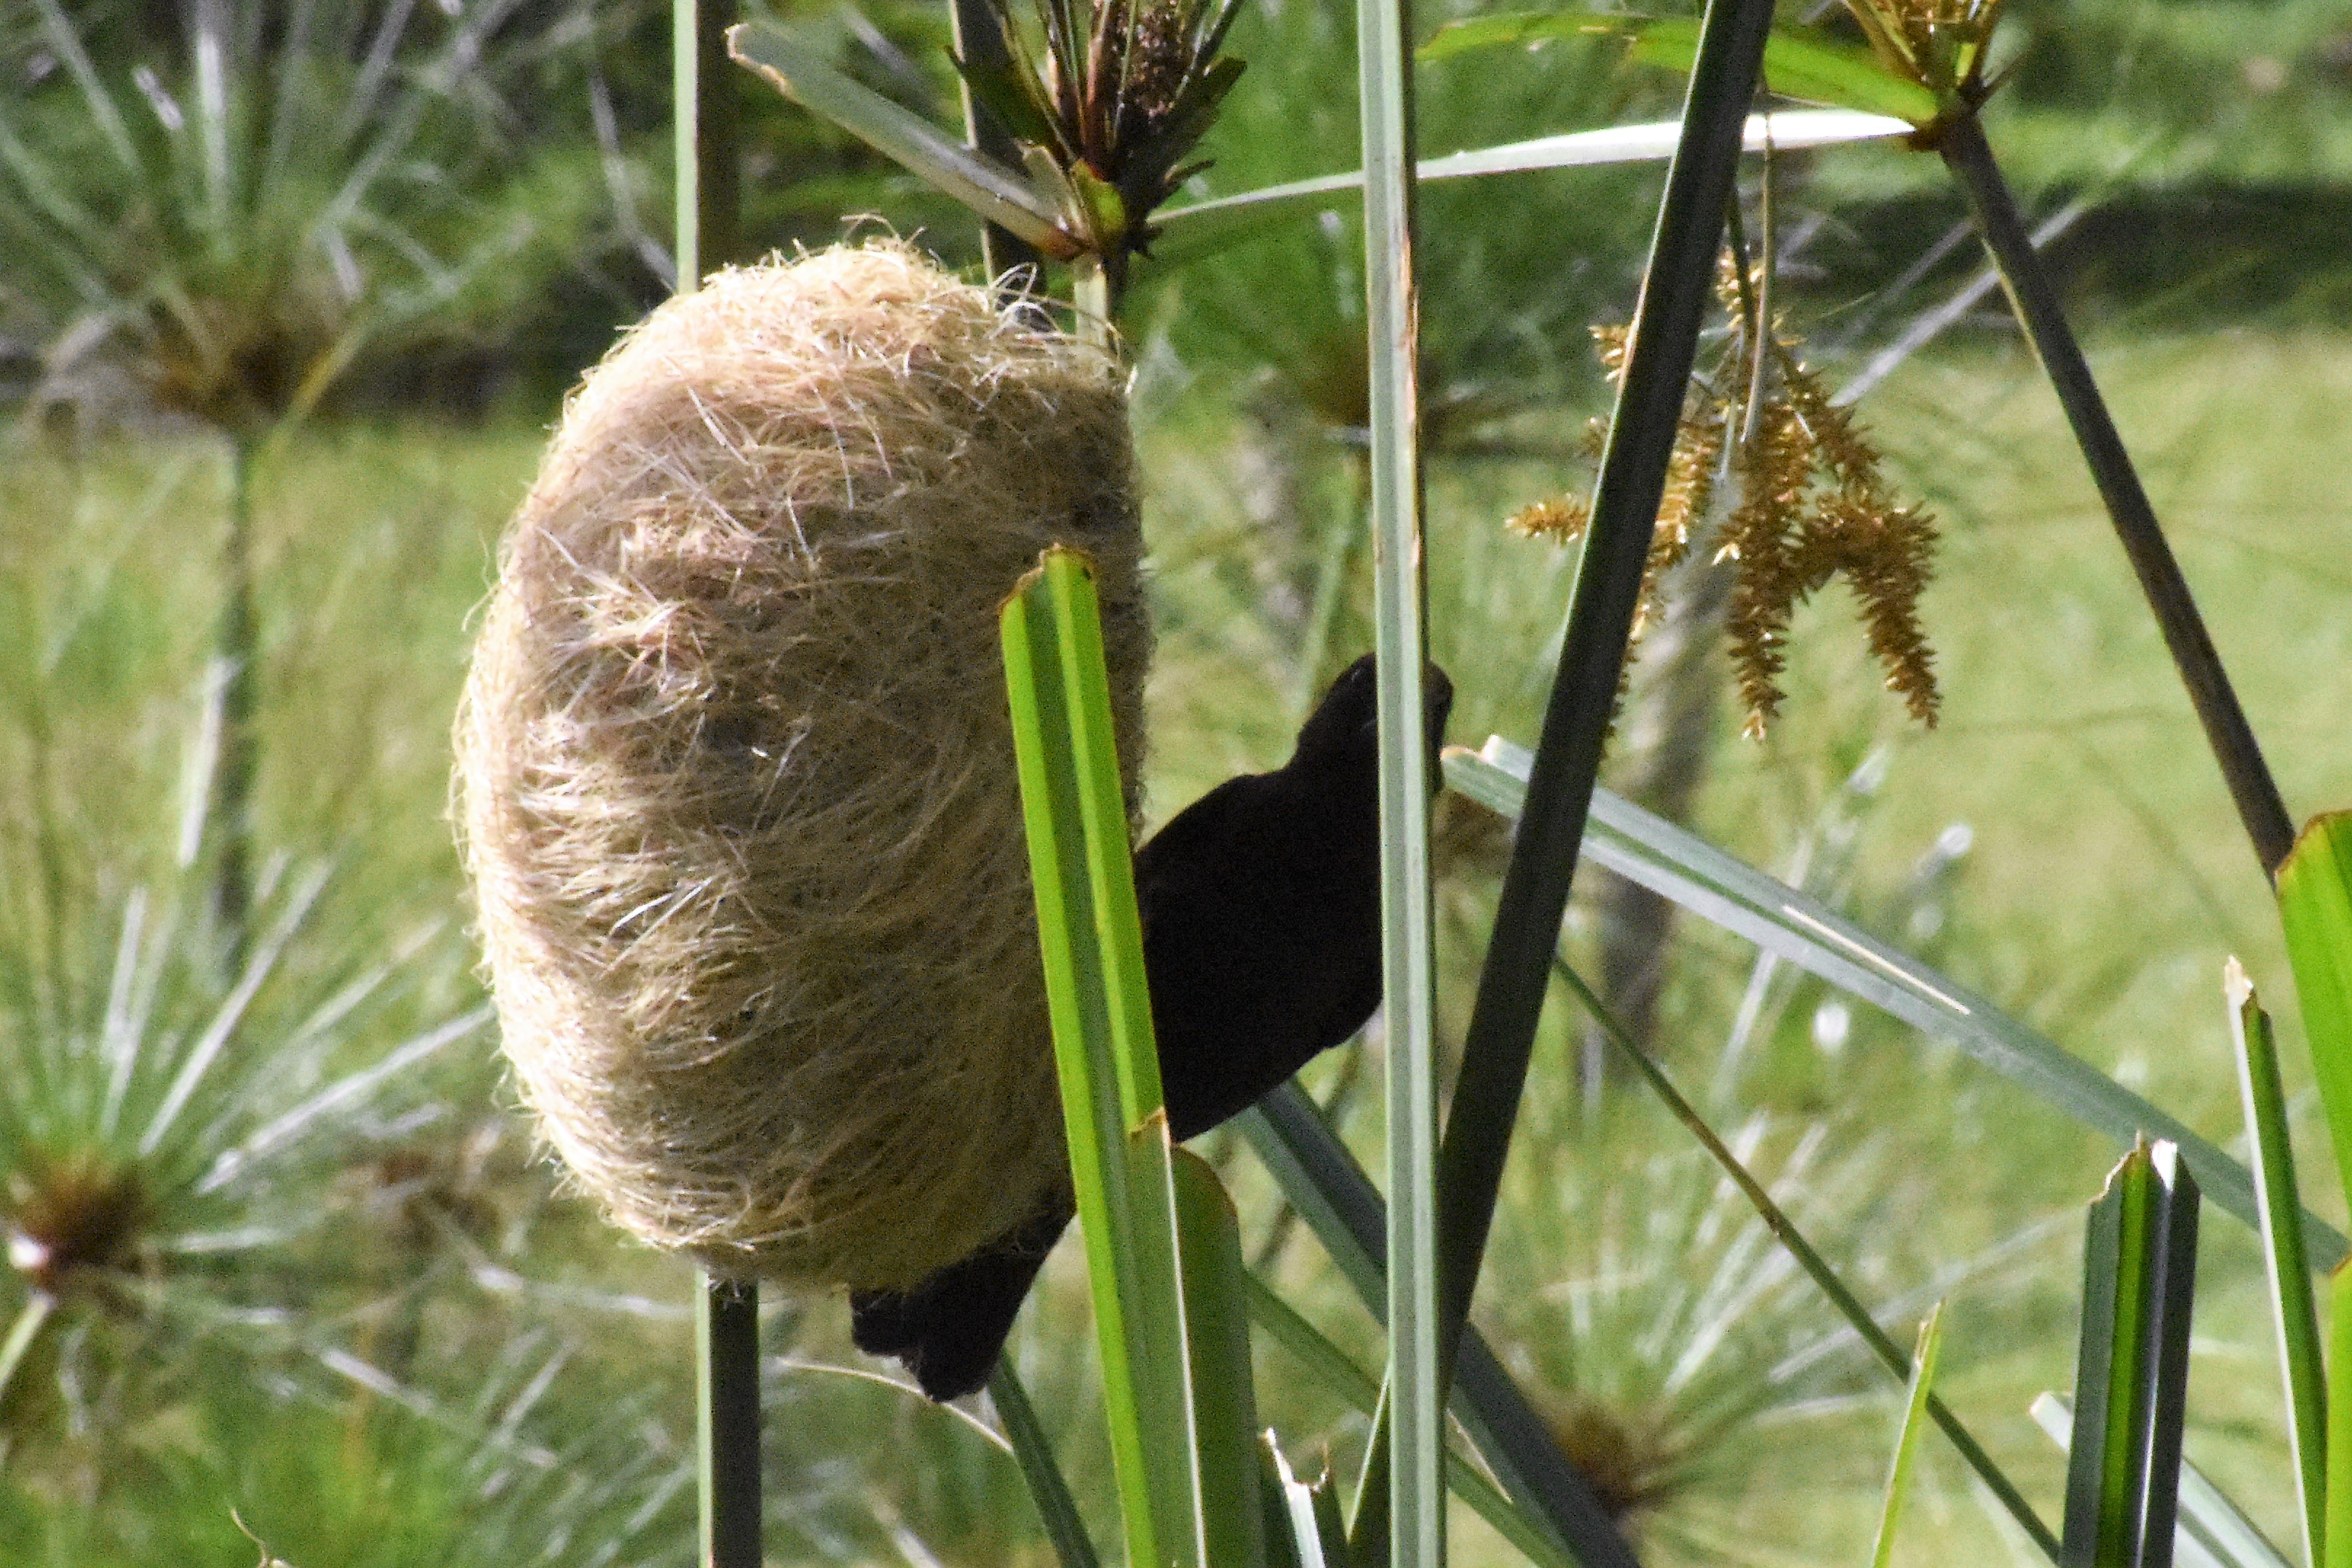
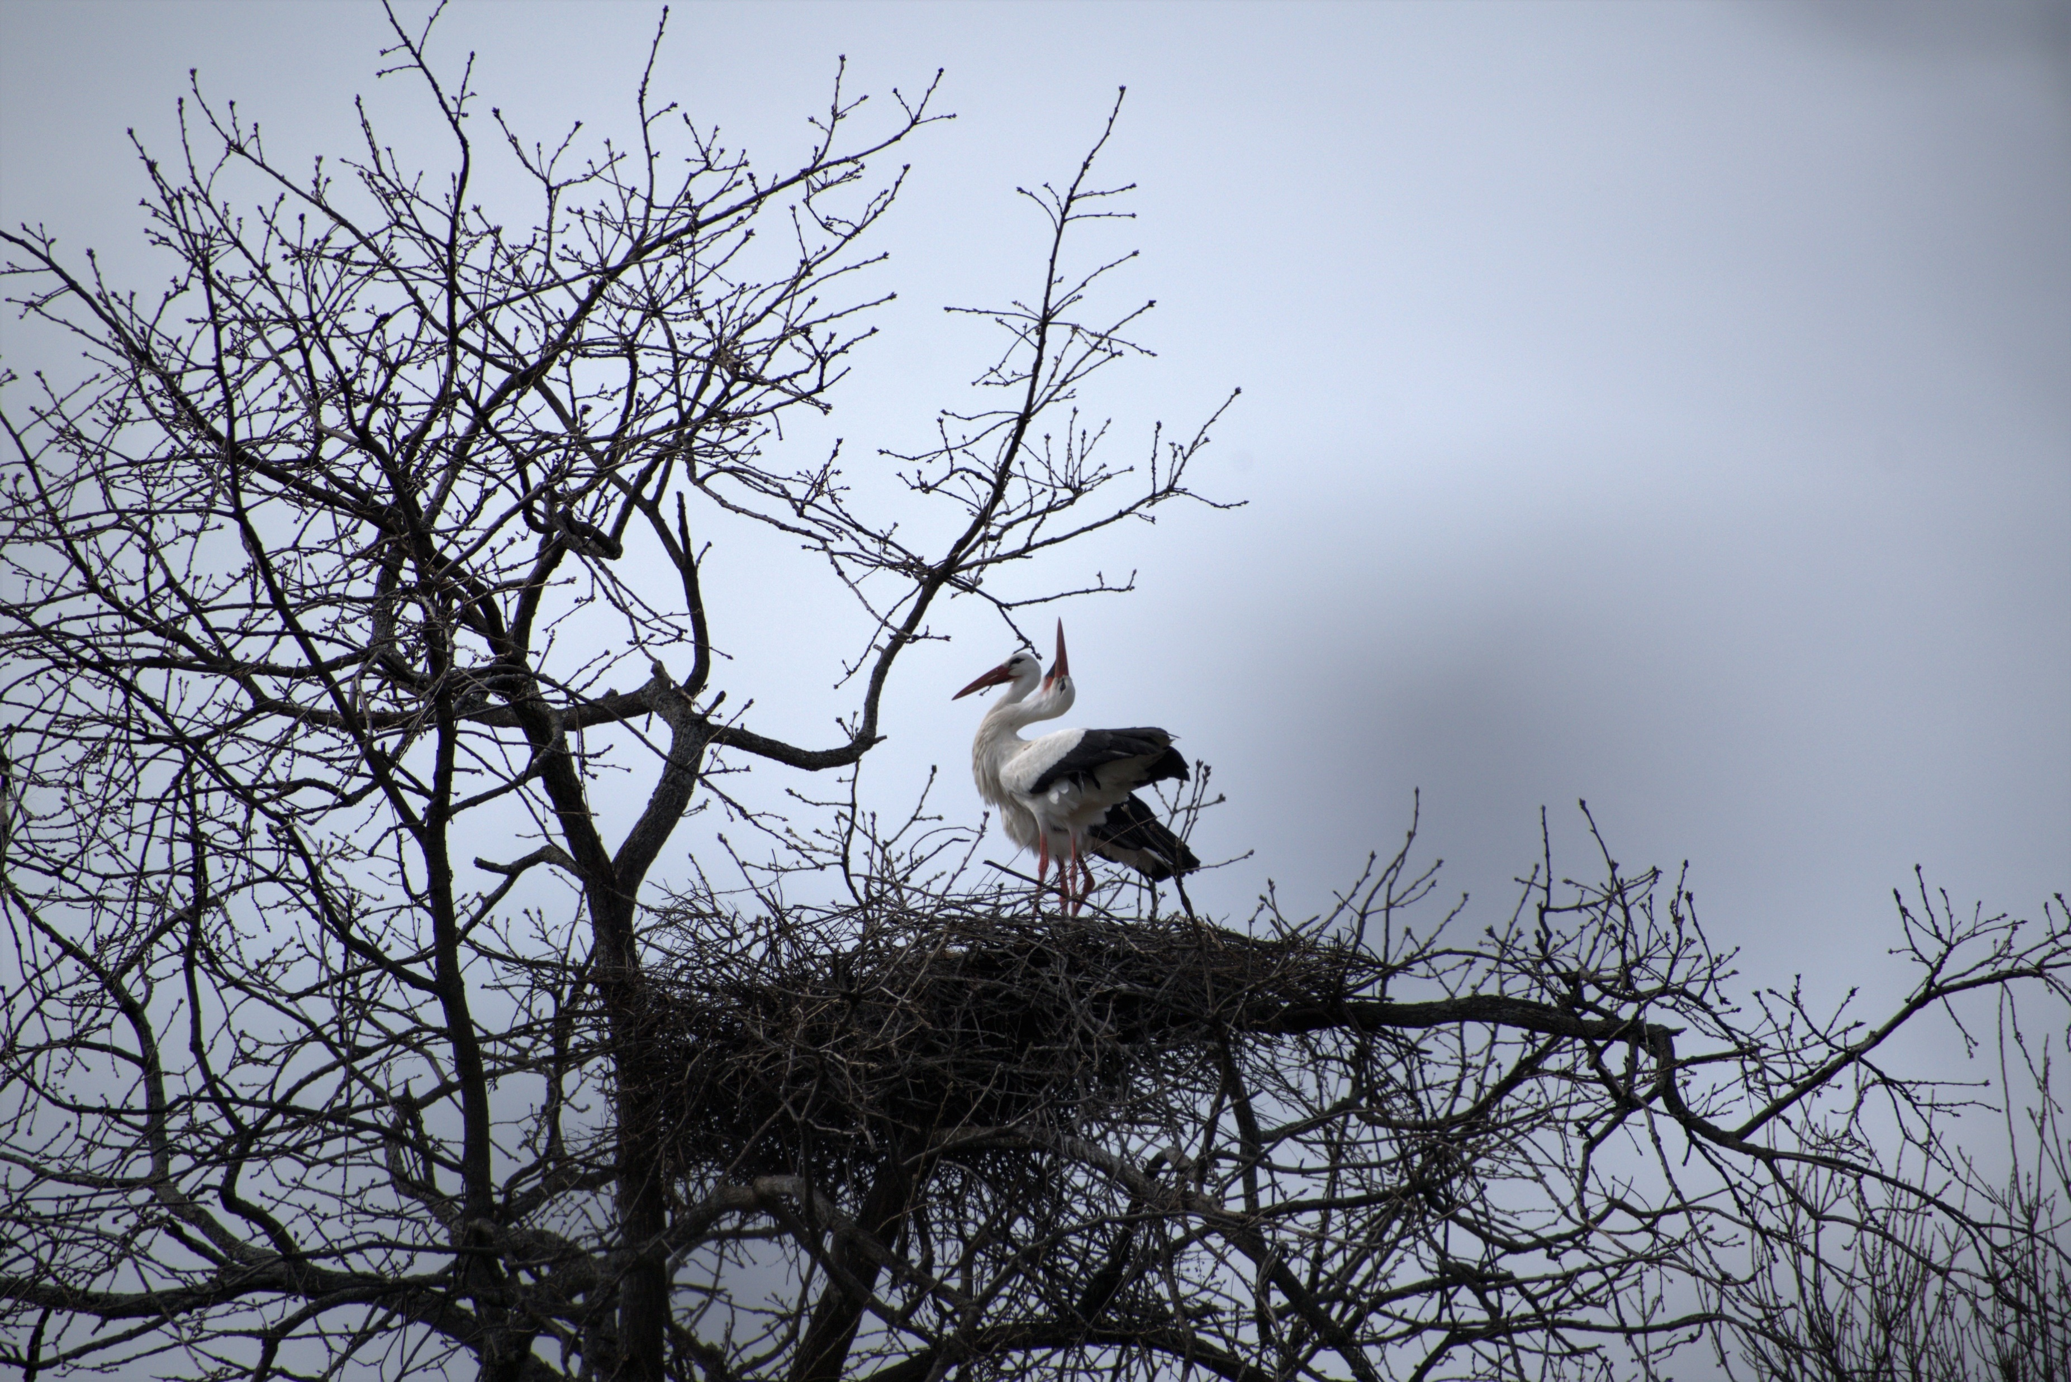
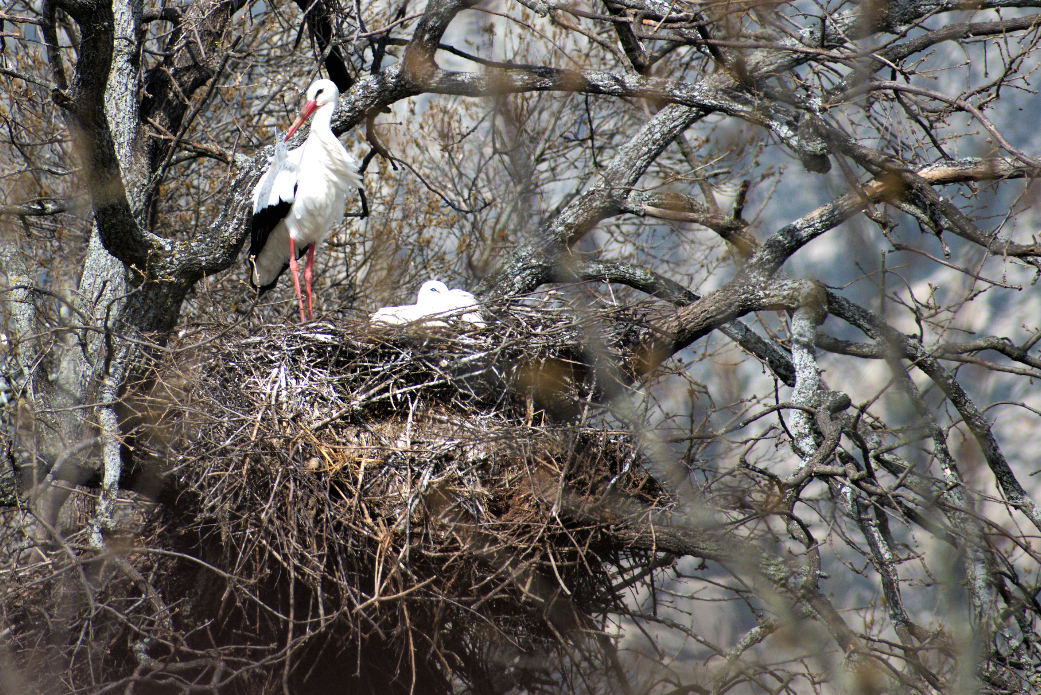
Notes:
What are the main functions of birds’ nests? Primarily, a breeding site. Small nest of some songbird, red kite, swallow or house martin (not sure), white stork, weaver bird in Tanzania.

Slide 12
RESEARCH TASK
Research nests from other species.
Read about at least 3.
Compare them.
Choose 1 – Construct a ppt presentation that includes the following: .
Image(s) of animal – title slide – Genus species name
How many individuals does it hold?
Is it temporary or permanent? When do they make it?
How long does it take to build? Individual or group effort?
Location (floor, tree, water)
(Images – from outside – inside – map?)
Sophisticated construction: Materials used to build
What biome and geographic location are these nest found in?
How does this home suit this organisms needs?

Slide 13
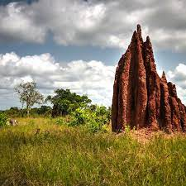
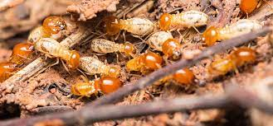
Guess who lives here
Notes:
termite

Slide 14
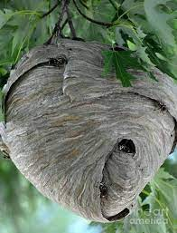
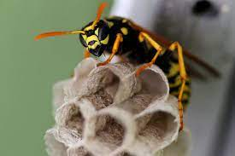
Guess who lives here
Notes:
Paper wasp

Slide 15
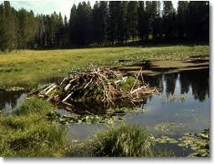
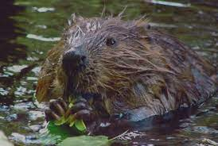
Guess who lives here
Notes:
beaver

Slide 16
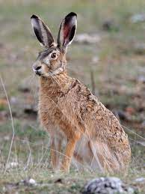
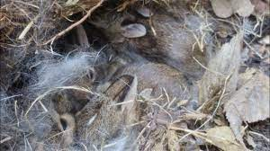
Guess who lives here
Notes:
Hare not rabbit! Distinguised by black tipps on ears, longer, more skeletal like.

Slide 17
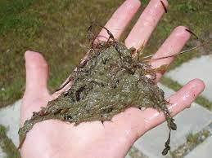
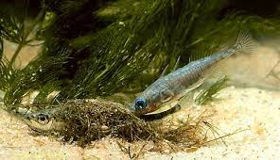
Guess who lives here

Slide 18
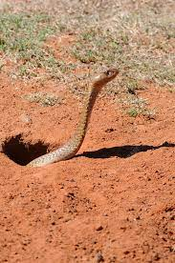
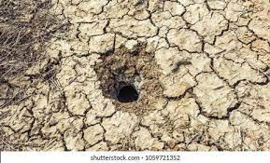
Guess who lives here
Notes:
Cape cobra female snake

Slide 19
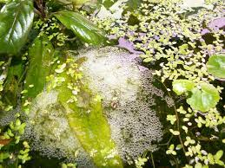
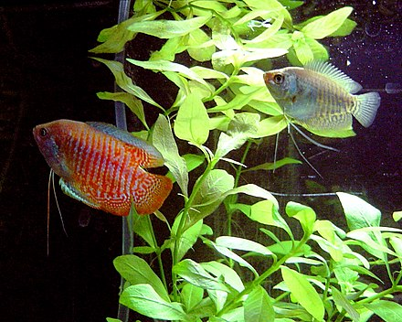
Guess who lives here
Notes:
Dwarf gouarami

Slide 20

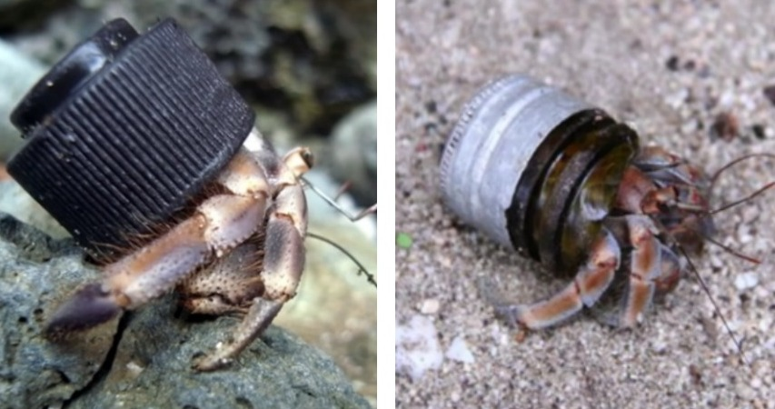
Guess who lives here
Notes:
Hermit crab

Slide 21

Thursday, 23 May 2024 Other organisms’ homes
Based on yesterday’s exploration
explain whether or not these homes are:
Sophisticated or simple?
For individual families or for large colonies?
Comfortable?
Permanent or temporary?
What do the homes provide for the organism?
Notes:
Give the students a few minutes to research other organisms’ homes, then ask the questions on the slide.
The last question can serve as a link as to how the function of modern human homes has evolved from a basic necessity to comfort.

Slide 22
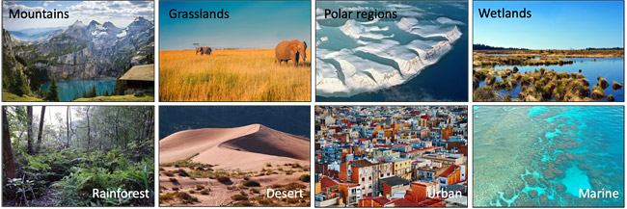
Where organisms live is their habitat
The main components of a habitat are shelter, water, food and space.

Slide 23
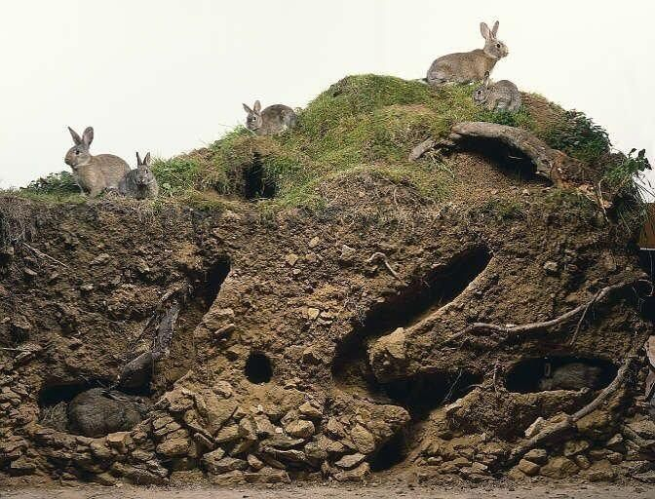
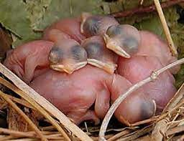
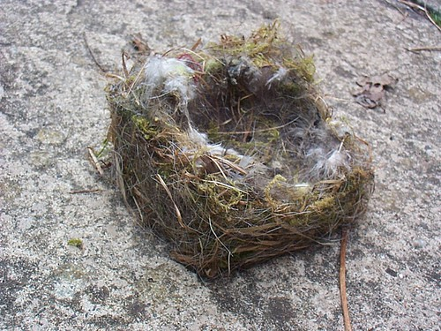
A shelter provides insulation

Slide 24
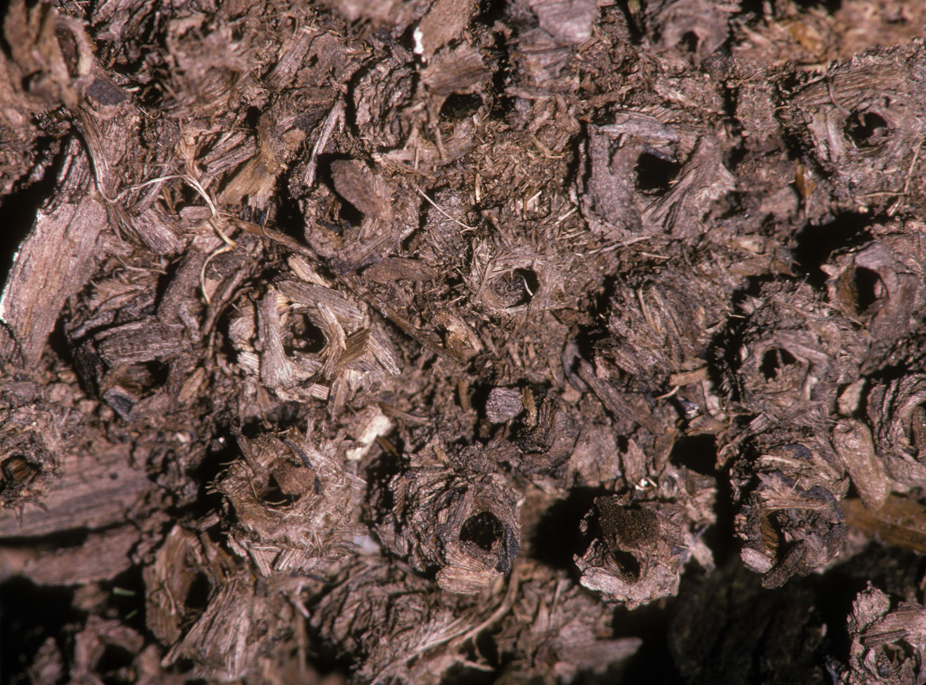
A shelter can be water-proof
A nest of caddisfly larvae sits on a stream bottom

Slide 25
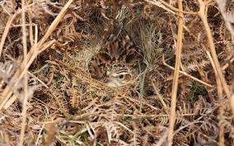
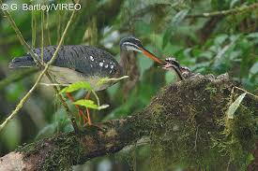
A shelter can blend in with the environment for safety

Slide 26
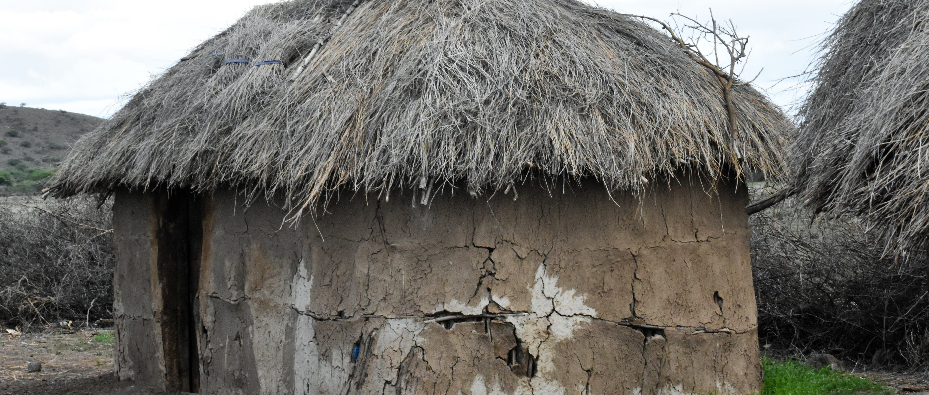
Other peoples’ homes
Outline ways in which this home is similar and/or different to yours.
Notes:
What exactly is required for us to call something home?

Slide 27
Extensions
Read this article Why these birds carry flames with their beaks.
https://www.nationalgeographic.com/animals/article/wildfires-birds-animals-australia
Or
Watch this video 7 NESTS THAT WILL CHANGE THE WAY YOU THINK ABOUT BIRDS
https://www.youtube.com/watch?v=mhWDCcBhxLQ

Slide 28
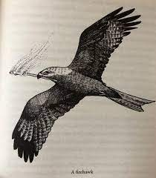
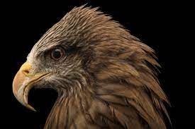
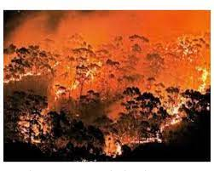
Fire-proof or not
Why do you think Fire-Hawks start fires?
Many species actually require fire. Heat from the flames can stimulate some fungi, like morel mushrooms, to release spores. Certain plants will seed only after a blaze. And some animals, such as mule deer and black-backed woodpeckers, require burned areas to both eat and nest. Without fire, those organisms can't reproduce—and anything that depends on them will be affected.
Forest animals typically have some ability to escape the heat. Birds may fly away, mammals can run, and amphibians and other small creatures burrow into the ground, hide out in logs, or take cover under rocks. And other animals, including large ones like elk, will take refuge in streams and lakes.
Nonetheless, the intensity of today’s wildfires is something even many fire-adapted species aren’t able to cope with.
Eucalyptus trees contain oils so flammable that the trees can explode if ignited.

Slide 29

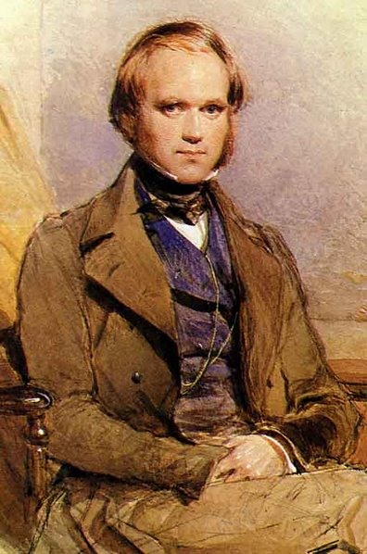
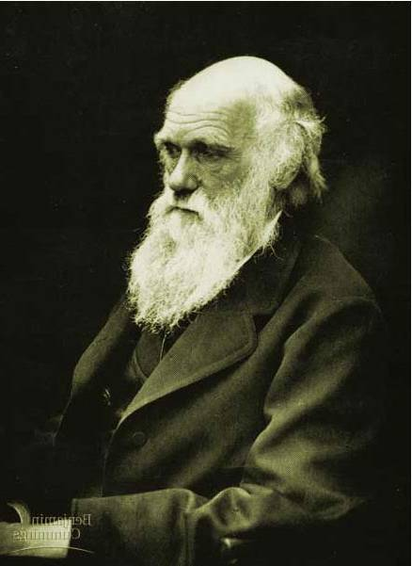
Evolution
by
Natural Selection

Slide 30
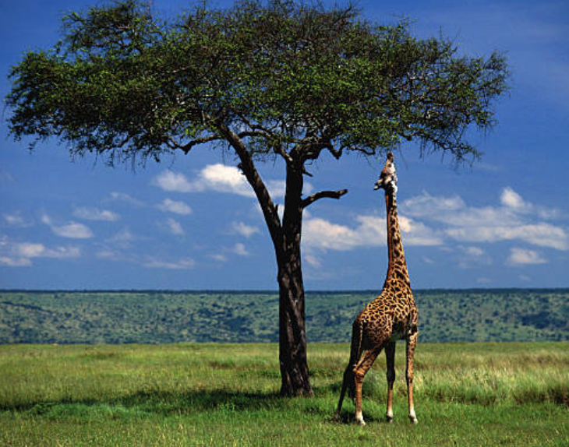
Evolution.
The cumulative change in the heritable characteristics of a population.
  cumulative means small changes upon small changes over many generations
  heritable refers to characteristics determined by organisms´ genetic makeup
  population refers to a group of organisms of the same species living in the same location

Slide 31
Which explanation sounds better?
One scientist believes that the giraffe had a long neck because its neck grew longer during its lifetime, as it stretched to reach leaves in high-up trees; causing each generation of giraffe to have a longer neck on average than previous generations.
One scientist believes that longer necked giraffes were more likely to survive. This would be because they could eat leaves from taller trees, so more long-necked giraffes will be born, while shorter necked giraffes struggled to survive and reproduce. Eventually all giraffes have longer necks because they were a better fit for their environment.

Slide 32


Charles Darwin
1809-1882
British naturalist
Proposed the idea of evolution by natural selection
Collected clear evidence to support his ideas
Notes:
What did Darwin say?
What evidence supports Evolution by Natural Selection?
What impact did Evolution have on biology?

Slide 33


Darwin found… birds
Collected many different birds on the Galapagos Islands.
Thought he found
very different kinds…
Finch?
Sparrow?
Finch?
Sparrow?
Warbler?
Woodpecker?
Warbler?
Woodpecker?

Slide 34

But Darwin found… a lot of finches
Darwin was amazed to
find out:
All 14 species of birds
were finches…
But there is only one species of finch on the mainland!
Large Ground
Finch
Small Ground Finch
Finch?
Sparrow?
Finch?
Sparrow?
How did
one species
of finches become
so many different
species now?
Warbler Finch
Veg. Tree Finch
Woodpecker?
Warbler?
Woodpecker?
Warbler?

Slide 35
Darwin´s 1st Observation
During his 5 year voyage on the HMS Beagle, Charles Darwin made observations of dozens of species, collected an abundance of fossils, and studied geological similarities and differences on the different continents as he circumnavigated the globe.
The first crucial observation which helped him propose Natural Selection many years later was the fact that variation exists within populations – and that this variation is what nature “selects.”

Slide 36
Variation
What is meant by variation?
  Variation is the fact that individuals of the same species show small differences.
How does variation arise?
  It arises from naturally occurring mutations in the DNA, and is compounded new genetic combinations in sexual reproduction.
Why is variation important?
  It is important because eventually, small variation contribute to survival and eventually to evolution and speciation.

Slide 37


Slide 38



Slide 39



Slide 40


Slide 41


Slide 42

Histogram shows frequency
How can we show variation numerically?

Slide 43


Tree Thinking
Descendant
species
Small-seed eater?
Ancestral
species
Large-seed eater?
Small Ground
Finch
Large Ground
Finch
Warbler?
Leaf-browser?
Warbler Finch
Veg. Tree Finch
Notes:
Darwin noted that the plants and animals of South America were very distinct from those of Europe.
Organisms from temperate regions of South America were more similar to those from the tropics of South America than to those from temperate regions of Europe.
Further, South American fossils more closely resembled modern species from that continent than those from Europe.

Slide 44

Correlation of species to food source
Seed
eaters
Flower
eaters
Insect
eaters
Rapid speciation:
new species filling new niches,
because they inherited
successful adaptations.

Slide 45

Darwin’s finches
Differences in beaks
  associated with eating different foods
  survival & reproduction of beneficial adaptations to foods available on islands
Warbler finch
Cactus finch
Woodpecker finch
Sharp-beaked finch
Small insectivorous
tree finch
Warbler
finch
Small ground
finch
Large
insectivorous
tree finch
Cactus
eater
Tree finches
Medium
ground finch
Ground finches
Insect eaters
Seed eaters
Vegetarian
tree finch
Large
ground finch
Bud eater

Slide 46

Darwin’s finches
Darwin’s conclusions
  small populations of original South American finches landed on islands
    variation in beaks enabled individuals to gather food successfully in the different environments
  over many generations, the populations of finches changed anatomically & behaviorally
    accumulation of advantageous traits in population
    emergence of different species

Slide 47

Natural selection
  variation exists in populations
  over-production of offspring
    more offspring than the environment can support
  competition
    for food, mates, nesting sites, escape predators
  differential survival
    successful traits = adaptations
  differential reproduction
    Beneficial adaptations (traits/abilities) become more
    common in population
Survival of the fittest – as the organisms in a population differ slightly from one another, the challenges posed by their habitat selects some individuals over others based on the impact their traits have on survival.

Slide 48


LaMarckian vs. Darwinian view
LaMarck
  in reaching higher
  vegetation giraffes
  stretch their necks & transmits the acquired longer neck to offspring
Darwin
  giraffes born with longer necks survive better & leave more offspring who inherit their long necks
✓

Slide 49






Fossil record
1. What are the lines of evidence that support Darwin’s ideas?
550
500
450
Equus
400
350
Body size (kg)
300
250
Merychippus
200
150
Mesohippus
Hyracotherium
100
50
Nannippus
60
55
50
45
40
35
30
25
20
15
10
5
0
Millions of years ago
Notes:
sedimentary rock
sequence: older fossls on bottom, younger fossls on top

Slide 50






Anatomical evidence
2. What are the lines of evidence that support Darwin’s ideas?
Notes:
Anatomical evidence
1. These structures are called… homologous
2. These structures are evidence for…. common ancestry
3. similar internal structure = similar development
4. different function = different environment & niche
5. close evolutionary r’ship!

Slide 51






Artificial selection
3. What are the lines of evidence that support Darwin’s ideas?
Cabbage
Terminal
bud
Brussels sprouts
Lateral
buds
Flower cluster
Leaves
Kale
Cauliflower
Stem
Flower
and
stems
Broccoli
Wild mustard
Kohlrabi
Notes:
Artificial selection
Hidden variation can be exposed through selection!

Slide 52

4. What are the lines of evidence that support Darwin’s ideas?
Comparative biochemistry
The sequence in
DNA & proteins
is a molecular
record of evolutionary
relationships.
Why compare
DNA & proteins
across species?
Human
Macaque
Dog
Bird
Frog
Lamprey
-comparison of molecules from organisms for degree of similarity
8
32
45
67
125
Why compare
these genes?
0
10
20
30
40
50
60
70
80
90
100
110
120
compare common genes
  cytochrome C (respiration)
  hemoglobin (gas exchange)
Number of amino acid differences between
hemoglobin (146 aa) of vertebrate species and that of humans
Notes:
Molecular Record
What are we comparing here? -→ comparing DNA (base sequence) & proteins (amino acid sequence)
What assumption do we make
about genes and relatedness? → the more closely related, the more DNA bases & amino acids you have in common
have to compare genes for protein the organisms have in common… can’t compare genes for proteins you don’t have

Slide 53
Entrance task
Write a short explanation regarding how variation relates to evolutionary change in a population.

Slide 54
Natural selection
Stated clearly: https://www.youtube.com/watch?v=0SCjhI86grU
Peppered moths
http://peppermoths.weebly.com/
https://www.youtube.com/watch?v=etsjB-6u-6w

Slide 55
Natural selection
Darwin observed:
Species produce far more offspring than the environment can support, yet population size stays stable
Species vary, some of it is inherited
He concluded:
That means that there is struggle for survival
The individuals with the most favourable characteristics, survive, and reproduce, passing on their favourable alleles
Over many generations, a species becomes well adapted/fit to its environment

Slide 56
Changing environment…
Selection pressure from the environment could change… meaning what is “fit” at one time may be detrimental or neutral at another time.
However, the environment does not need to change for a population to evolve as the variation can be acted upon over generations in the same environment

Slide 57


Adaptation
Important word in the context of evolution
Refers to traits that confer a survival advantage to organisms …such as
  camouflage for peppered moths or stick bugs
  sharp claws for eagles
  strong jaw muscles for lions
Brainstorm a list of at least 5 addition animal adaptations – and provide a brief explanation for each as to how it helps with survival

Slide 58
Natural Selection experiment
Handout. Exploration.
Design own experiment.

Slide 59
Entrance task
Using the classical example of cheetah speed, explain how natural selection could lead to an increase in running speed over time.
  (make sure your answer references 1.variation, 2.struggle for survival, 3.adjustment of the population over time)

Slide 60

Speciation is….
The process in which a single population or species branches into separate groups that are no longer reproductively compatible.

Slide 61

Speciation

Slide 62

How do new species originate?
Populations must become isolated
    geographically isolated
    reproductively isolated
  isolated populations evolve independently
After sufficient time, the two groups will no longer be reproductively compatible with one another – and will be considered separate species.

Slide 63

Evolution: Speciation
Mom, Dad…
There’s something
you need to know…
I’m a MAMMAL!

