Slide 1
Electricity in nature

Slide 2
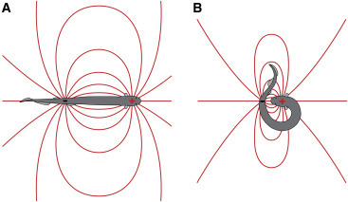
ELECTRIC EELS https://www.youtube.com/watch?v=z0M7_HPSi14

Slide 3
Electric circuit components

Slide 4
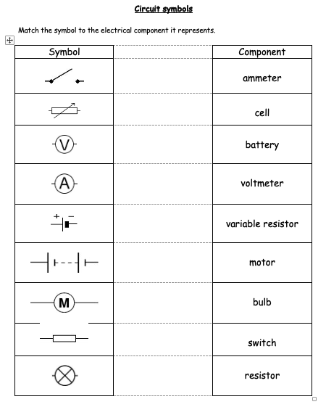

Slide 5
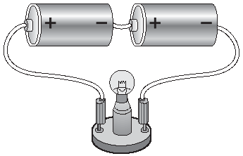
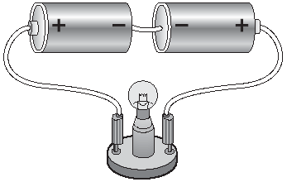
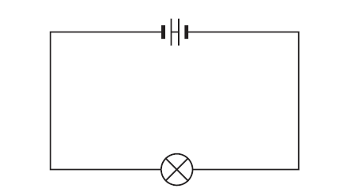
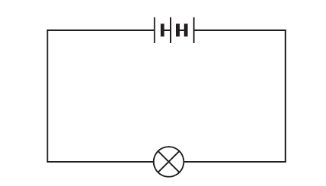
Which ones won’t work?

Slide 6
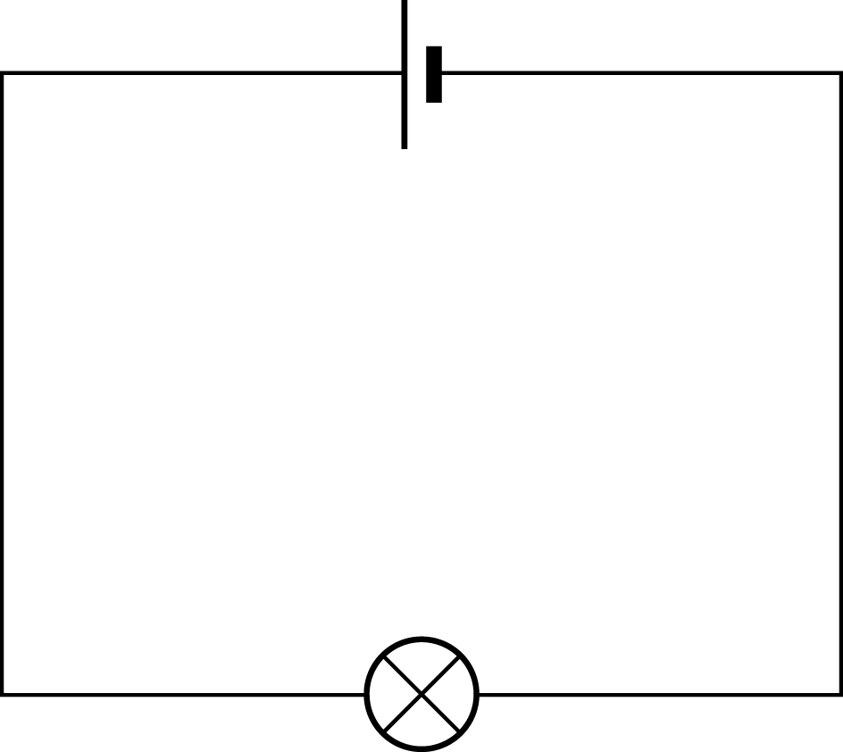
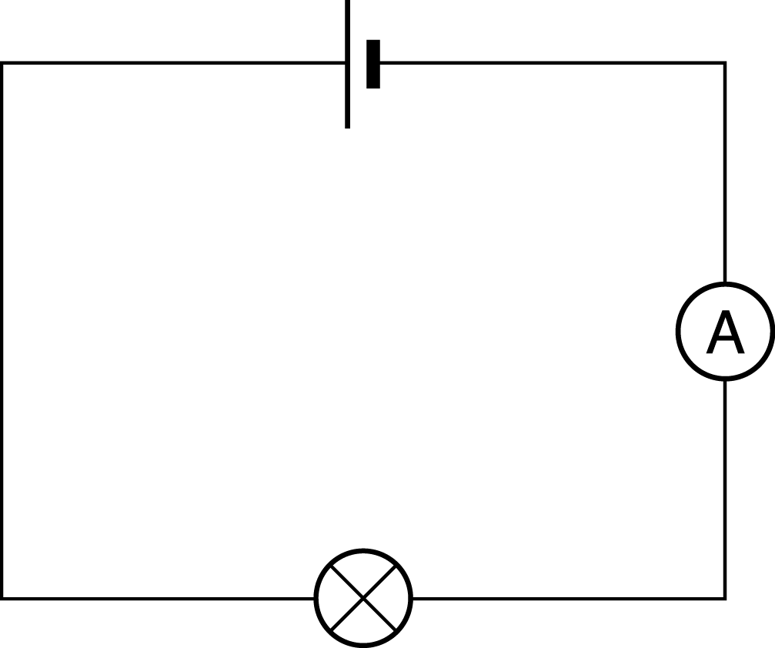
Will the bulb light?

Slide 7
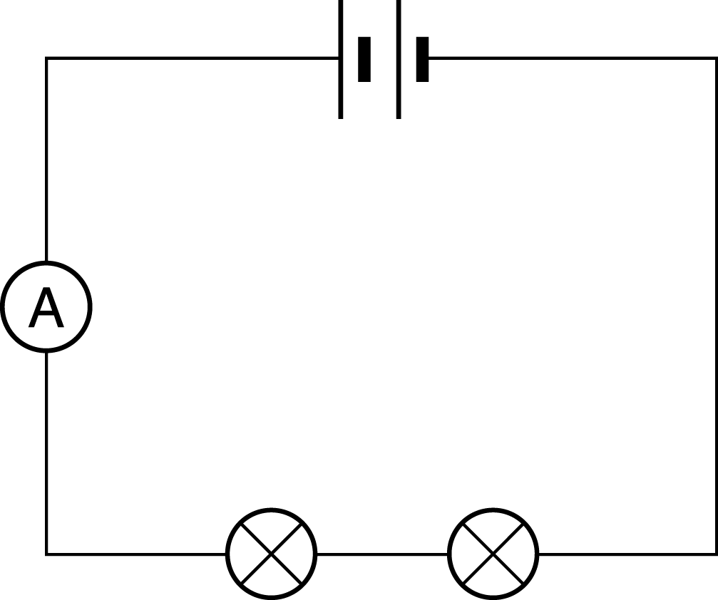
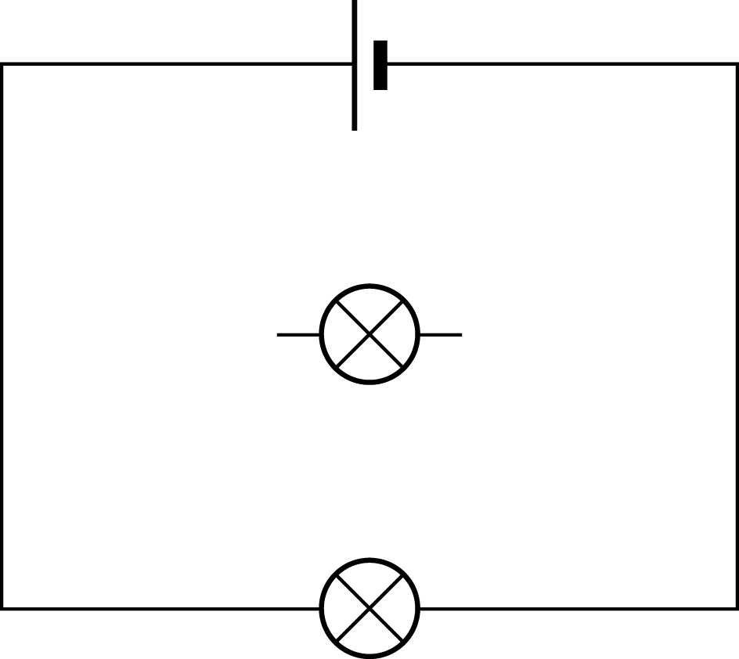
Will the bulb light?

Slide 8
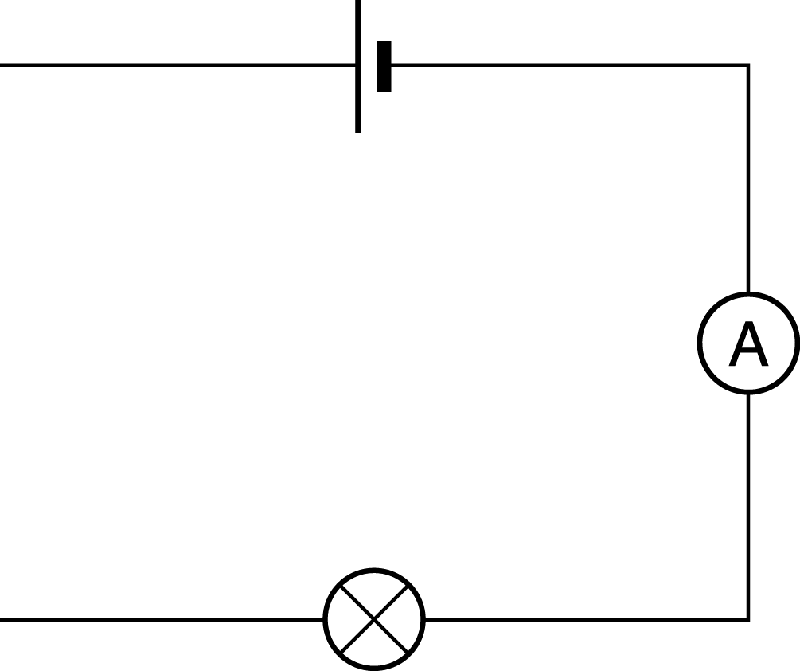
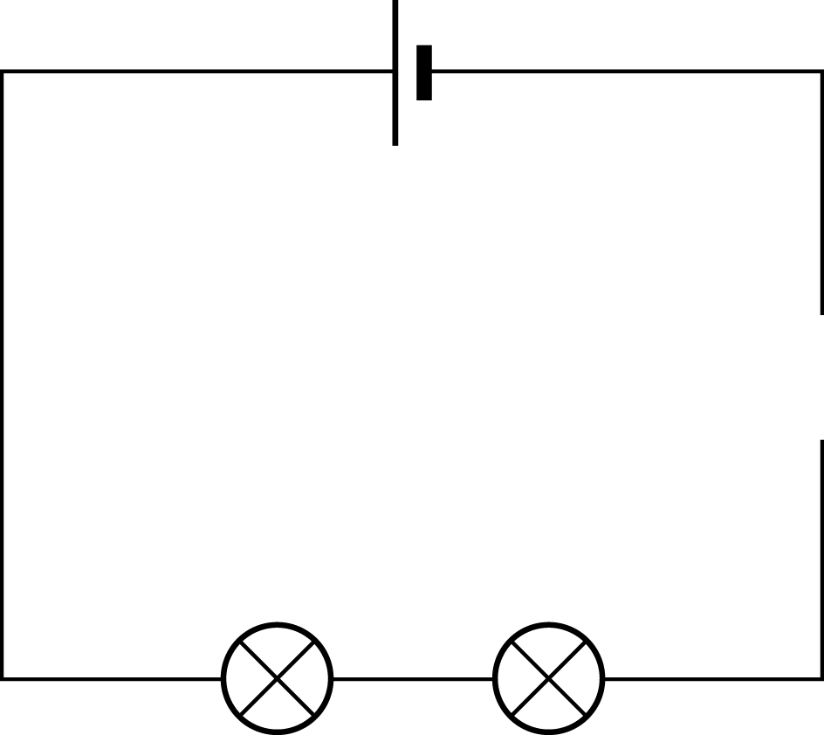
Will the bulb light?

Slide 9
Set up an electrical circuit that shows that electricity is flowing
https://phet.colorado.edu/en/simulations/circuit-construction-kit-dc

Slide 10
Draw it in your notebook

Slide 11
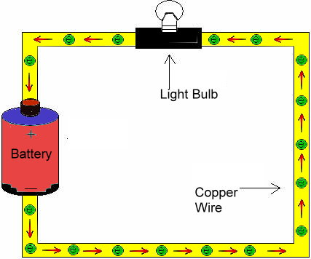
A simple circuit showing electron flow.

Slide 12
Electrical Charge
Electric charge is given the symbol
Q
Electrons are the charge carriers
that flow in an electrical circuit –
from the negative to positive terminals.
2.21 mins https://www.youtube.com/watch?v=oB1v-wh7EGU

Slide 13
Electrical Charge
Electrons are so very, very tiny that we measure large groups of them called coulombs. There are 6.25 x 10¹⁸ electrons in one coulomb.
The charge on one electron is 1.6 x 10⁻¹⁹ coulombs (C)

Slide 14
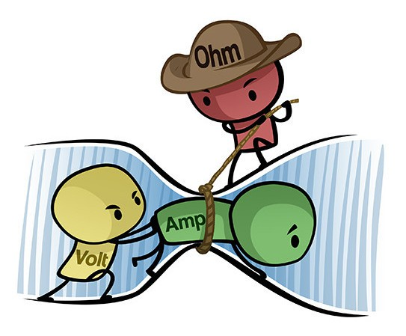
Try to explain this cartoon

Slide 15
Charge, Current & Time
Electric current is given the symbol
I
Current is the amount of charge flowing per second and is given the unit
Amps (A)

Slide 16
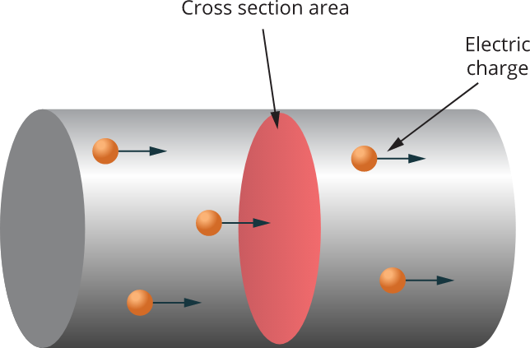

Slide 17
Charge, Current & Time
If current is charge flowing per second then
Charge transferred in coulombs (C)
time in seconds (s)
Current in Amps (A)

Slide 18
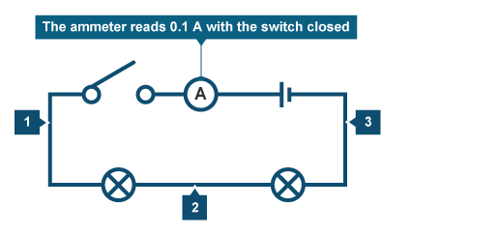
Experiment to measure current in series
ammeter
12v
Set up a series circuit with two 12v bulbs and a powerpack with a switch. Measure the current flowing at points 1, 2 and 3
https://phet.colorado.edu/en/simulations/circuit-construction-kit-dc

Slide 19
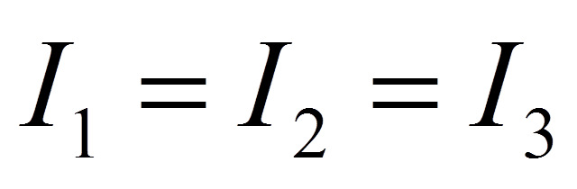
Kichoff’s first law
The current is the same at all points in a series circuit
Charge (electrons) don’t get used up.
Charge is conserved.

Slide 20
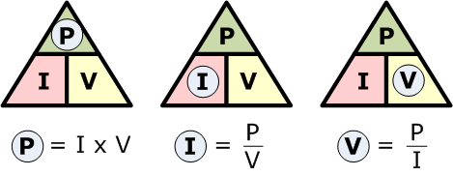
Working out power

Slide 21
Calculate the power
1. A series circuit had a current of 2.0 amps and the voltage of the bulb is 3.0 volts. Calculate the power.
2. A series circuit had a current of 4.5 amps and the voltage of the buzzer is 2.0 volts. Calculate the power.

Slide 22
Can you find the mistakes in this paragraph about current?
Current is the amount of electricity flowing around a circuit. We measure current using an Amp. Current is measured in Volts. The current is the same anywhere in a circuit, so it does not matter where an ammeter goes in a circuit. Current is used up as it goes around the circuit.

Slide 23
Summary
 | CURRENT | VOLTAGE
Measured in
Measure with
Amps, A
Volts, V
Ammeter
Voltmeter

Slide 24
Experiment to measure voltage in series
ammeter
12v
Add the voltmeter to the following components and record the voltage:
Bulb 1
Bulb 2
https://phet.colorado.edu/en/simulations/circuit-construction-kit-dc

Slide 25
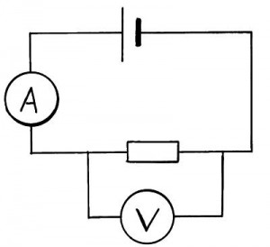

How can we measure voltage?
Voltage (or potential difference) can be measured using a voltmeter.
An ammeter is connected in the circuit in series but a voltmeter must be connected across (hug) the component (in parallel).
V

Slide 26
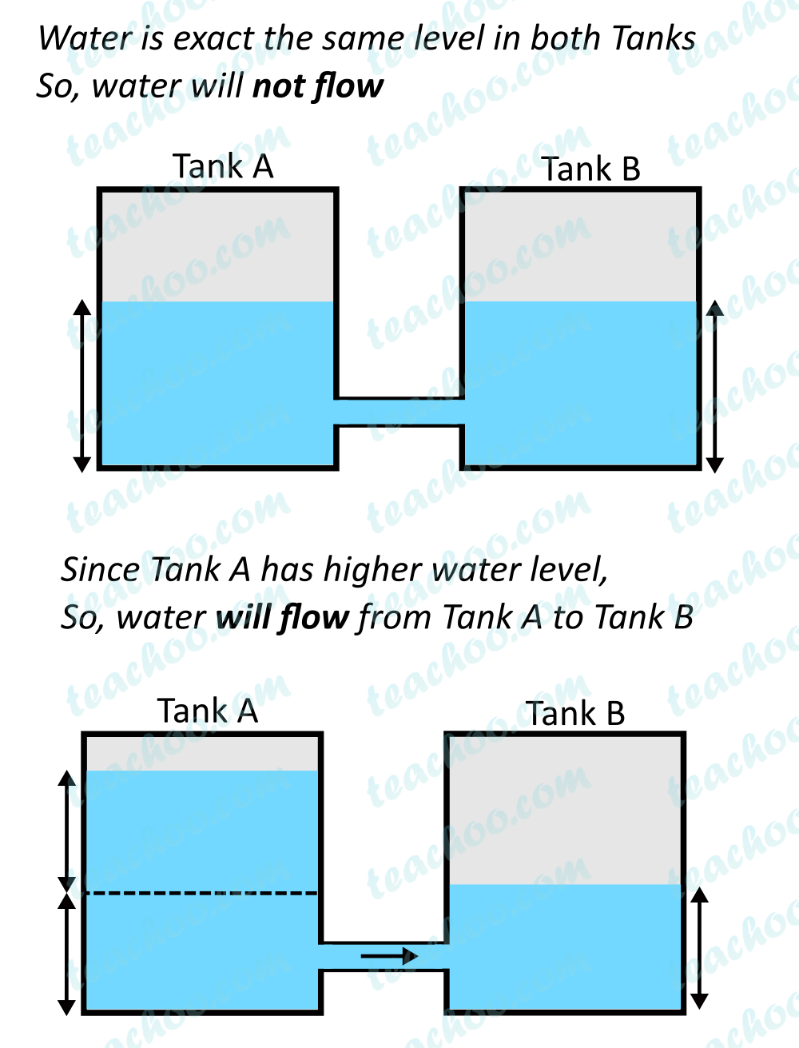
Voltage (or potential difference)

Slide 27
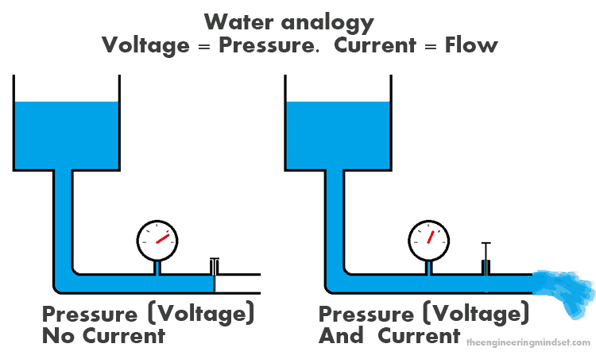
Voltage

Slide 28
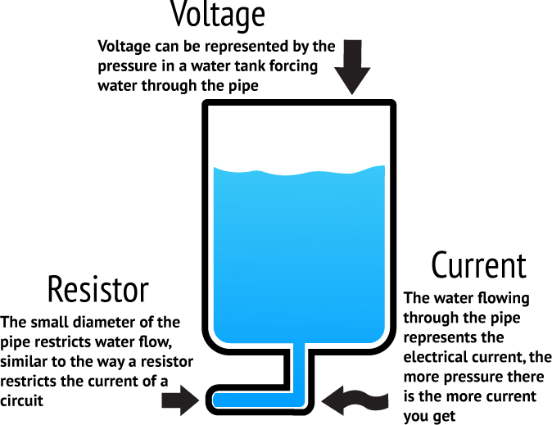

Slide 29
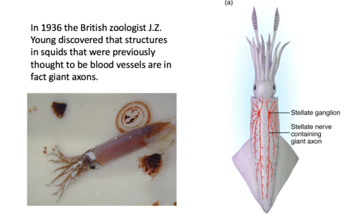
Voltage in the nervous system

Slide 30
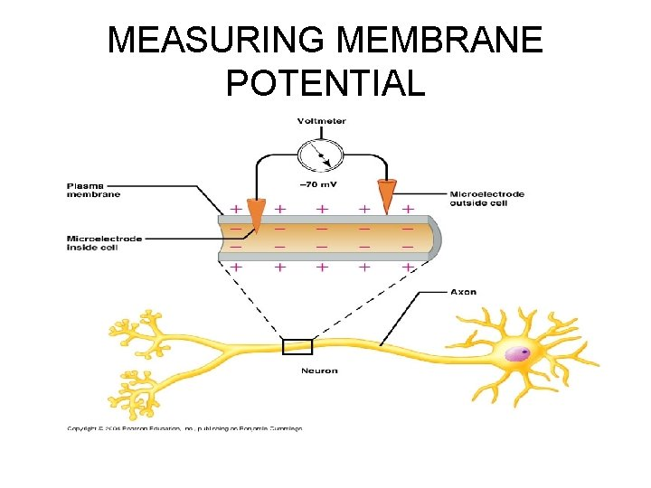

Slide 31
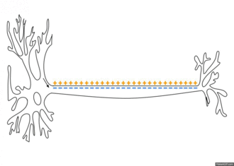
Membrane potential = difference in charges between two locations

Slide 32
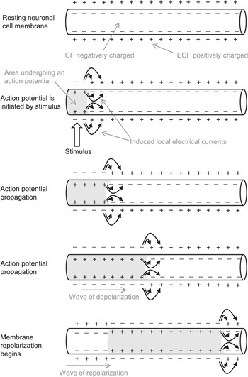

Slide 33
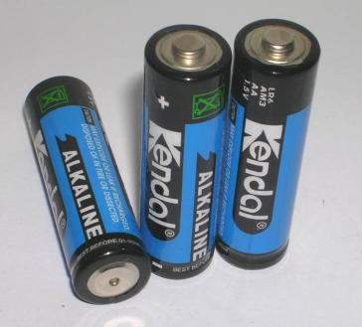
What is the energy change which takes place in a battery?
Chemical to Electrical

Slide 34
When a battery is in a circuit…
The electrical energy is carried by the electrons that move round the circuit.
It is converted into others forms of energy.

Slide 35
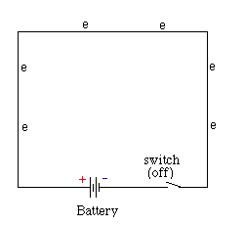
The coulombs start with (for example) 12J of energy each.
They have “electrical potential energy”.
As the coulombs travel round the circuit this energy is changed to other forms.
When the coulombs have travelled back to the battery they have transferred all their energy to other forms.

Slide 36
Where does most of the energy tranformation take place?
In the conducting wires the coulombs lose very little energy as the wires are made of a conductor (copper).
The light-bulb filament is made of resistance wire and this causes the coulombs to lose most of their energy in the bulb.
When the coulombs get back to the battery they have transferred all of their electrical potential energy and have no energy left.

Slide 37
What has “potential difference” got to do with voltage?
It is the same thing!
The potential difference (p.d.), or voltage (unit volts),of a battery or cell is a measure of the electrical energy given to one coulomb of charge passing through the battery.
Volt = joule/coulomb
V = E/Q

Slide 38
Energy is conserved
The voltage of the supply is the energy given to each Coulomb.
The voltages across each bulb is the energy lost by each coulomb as it travels through.
If we can ignore the conducting wires then by conservation of energy
V_{s} =V₁+V₂

Slide 39

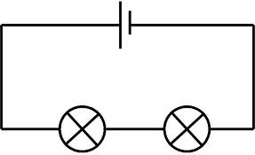

Measuring Voltage in series circuits
s
Measure the voltage across the supply Vs
Measure the voltage across the first light bulb V₁
Measure the voltage across the second light bulb V₂
2
1
Write an equation connecting Vs, V_{1,}and V₂
https://phet.colorado.edu/en/simulations/circuit-construction-kit-dc

Slide 40
Measuring Voltage in parallel circuits
https://phet.colorado.edu/en/simulations/circuit-construction-kit-dc
s
Measure the voltage across the supply Vs
Measure the voltage across the first light bulb V₁
Measure the voltage across the second light bulb V₂
2
Write an equation connecting Vs, V_{1,}and V₂
3

Slide 41
Summary
 | Series | Parallel
Current | SAME | SPLIT
Voltage | SPLIT | SAME

Slide 42
Disadvantages of Series Circuits
When one component breaks the whole circuit stops working as no current flows.
The voltage is divided between the bulbs. so the more bulbs added the dimmer each one is.
The components can’t be switched on and off separately

Slide 43
Advantages of a Parallel Circuit
When one bulb breaks the rest of the circuit continues to work.
The voltage in each branch is the same as the supply voltage. Therefore, bulbs in parallel will each be as bright as a single bulb.
Each component can be switched on and off separately.

Slide 44
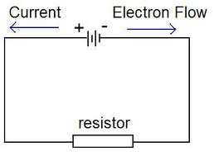
Conventional current
Very unfortunately when electricity was discovered the physicists decided that the charge flowing was positive!!!!!
We still use this conventional current but it really doesn’t make any difference which way the current flows !

Slide 45
RESISTANCE

Slide 46
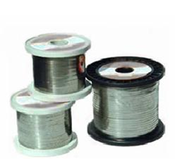
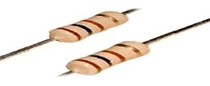
Resistors
The circuit symbol for a resistor is
Notes:
46
46

Slide 47
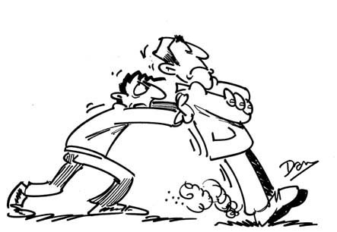
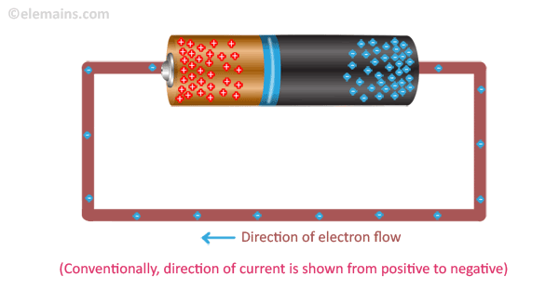
Electron flow and Resistance
As the electrons move along the wire they collide with the metal atoms. These collisions make the atoms vibrate more which makes the metal hotter.
Resistance is a measure of how much a material tries to stop electricity passing through it.
4 mins https://www.youtube.com/watch?v=ue6w5aXhxjU

Slide 48
Resistors Use these words to fill in the gaps below: insulators, copper, current, heat, resistors, conductors, alloys
Conductors such as cables have very little resistance and so very little electrical energy is changed to .
have very, very large resistances and so no________ can flow.
are inbetween.
They allow current to flow but not as well as____________
The bigger the resistance the smaller the __________
(for the same voltage).
Resistance wires are made of a mixture of metals e.g nichrome or constantin
copper
heat
Insulators
current
Resistors
conductors
current
alloys
Notes:
48
48

Slide 49

Definition of Resistance
The resistance of a resistor is defined as the voltage across the resistor divided by the current flowing through it.
Resistance = voltage
current
Volts v
OhmsΩ
Amps A
Ohm’s law
Notes:
49
49

Slide 50

Measure some resistances:
Put the power pack on 10v.
Measure the current and the voltage across a metal resistor.
Voltage = __________
Current = __________
Resistance R =V/I = ___
Find the resistance of a light bulb in the same way.
Find out what happens to the total current flowing when you put both the light bulb and the resistor in series.

Slide 51
What can you say about current and
resistance for a fixed voltage?
decreases
As resistance increases, the current…..
decreases
As resistance decreases, the current …..
increases
Notes:
51
51

Slide 52
Using Ohm’s law:
For a voltage of 12V, calculate the
current for a resistance of
4 Ω
24 Ω
1 k Ω
Notes:
52
52

Slide 53
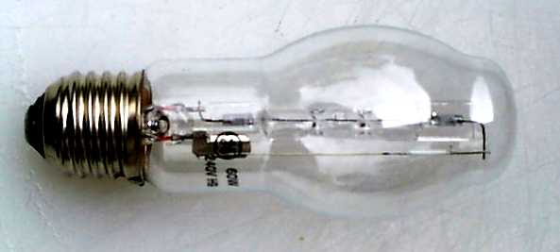
Resistance for a bulb
If you have a filament bulb and it has a current of 20A running through it, with a potential difference of 100V across it, what is the resistance of the bulb?
V = IR
R = V/I
R = 100V/20A
R = 5 Ω

Slide 54

Formula triangles
Formula triangles help you to rearrange formula, the triangle for the Ohm’s Law is shown below:
Whatever quantity you are trying to find cover it up and it will leave you with the calculation required.
…and you are left with the sum…
So if you were trying to find current, I…..
I = V
V
R
÷
÷
…you would cover I up…
I
R
x

Slide 55
Circuits Quiz.
What have you learnt?

Slide 56
What are the units of resistance?
Amps
Ohms
Volts
Watts
✓

Slide 57
If two resistors of 4 Ω and 4 Ω are placed in parallel, what is their total resistance in the circuit?
10 Ω
2 Ω
2.4 Ω
24 Ω
✓

Slide 58
If a resistor has a potential difference of 10V across it and a current of 0.2 A flowing through it.
What is its resistance?
50 Ω
2 Ω
0.5 Ω
15 Ω
✓

Slide 59
What type of circuit is this?
series
A
Name the components
V
V
Notes:
59
59

Slide 60
The supply voltage is 6V. What is voltage V₁? V₂?
10Ω
10Ω
V₁
V₂
Notes:
60
60

Slide 61
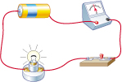
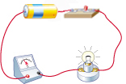
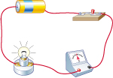
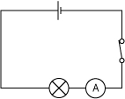
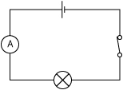
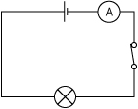
Match each series circuit to the correct circuit diagram.
A
B
C
3
1
2
2
3
1

Slide 62
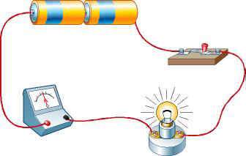
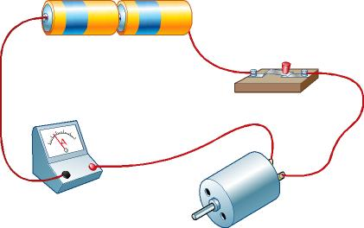
Both these circuits have the same number of batteries.
D
E
Why do the ammeters show different current readings?
There is less current in circuit E which means it's harder for the current to flow in the circuit with the motor.
Which component has the greater resistance?

Slide 63

7J Connecting circuits – Circuits quiz
1. The parts that are connected to make an electrical circuit are called…
a) computers.
b) components.
c) consonants.
2. The three things needed to make a circuit are a power supply, an electrical device and…
a) wires.
b) a plug.
c) batteries.
Notes:
TEACHER’S NOTES
Answers
1b)
2a)

Slide 64

7J Connecting circuits – Circuits quiz
3. The flow of electrical charge around a circuit is called the…
a) raisin.
b) battery.
c) current.
4. The symbol represents which electrical component?
a) A switch.
b) A bulb.
c) An ammeter.
Notes:
TEACHER’S NOTES
Answers
3c)
4b)

Slide 65



7J Connecting circuits – Circuits quiz
5. What is the symbol for a cell?
a)
b)
c)
6. When a switch is closed, an electrical circuit is said to be…
a) complete.
b) broken.
c) positive.
Notes:
TEACHER’S NOTES
Answers
5b)
6a)

Slide 66
7J Connecting circuits – Circuits quiz
7. Batteries should be connected so that their poles are arranged…
a) positive to positive.
b) negative to negative.
c) positive to negative.
8. When a circuit is broken, what happens to the current?
a) the current continues to flow.
b) the current changes direction.
c) the current no longer flows.
Notes:
TEACHER’S NOTES
Answers
7c)
8c)

Slide 67
RESISTANCE
EXTENSION

Slide 68

Varying Resistance
A variable resistor can be used to vary the current in a circuit
Notes:
68
68

Slide 69
Current for a diode
A diode has a current of 5A running through it, and a resistance of 5Ω. What is the potential difference across the diode?
V = IR
V = 5A x 5Ω
V = 25V

Slide 70
Lesson 2 and 3
Investigating how current varies with voltage for 3 different circuit components
By the end of the lesson you should be able to:
Describe how current varies with voltage in wires, resistors, metal filament lamps and diodes, and how this can be investigated experimentally.

Slide 71
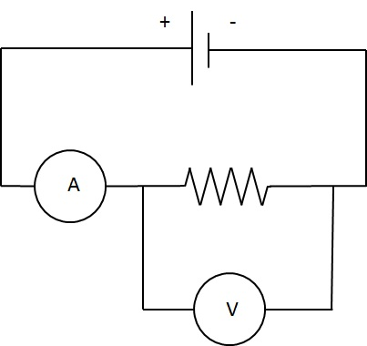
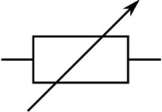
Experiment to investigate I/V curves for a resistor, a filament and a diode.
rheostat
Voltage V | Current I
Fixed resistor
In this circuit the rheostat is being used as a voltage divider

Slide 72
Variable Resistors
What do you expect
to happen to the current and the brightness of the bulb if you increase the value of the resistor in the circuit shown?
cell
A
lamp
Variable resistor
Notes:
72
72

Slide 73
Relationship between current and voltage in a fixed resistor
A straight line through
the origin tells us that current is directly proportional to voltage
The gradient of the line gives us the ratio of I/V.
current / Amps
The ratio V/I is the reciprocal of the gradient. It is equal to the resistance of the resistor.
A metal resistor has a constant resistance.But only if the temperature stays constant
voltage (volts)
Notes:
73
73

Slide 74
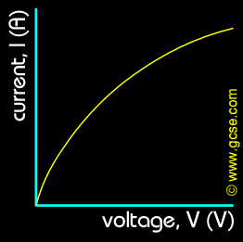
I/V curve for a light bulb
The gradient is decreasing and so the resistance of the filament must be increasing.
The current is increasing as voltage increases but not as much as for a constant resistance.

Slide 75
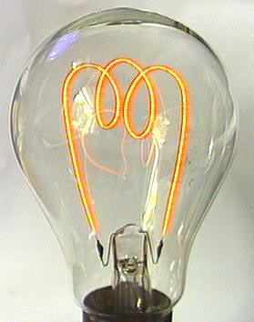
Filament Lamp
Electric current
passes through the
resistance wire which
is made of tungsten.
Electrical energy is
changed into heat
energy and the
wire glows white hot.
Filament lamps
produce both heat and
Light.
Notes:
75
75

Slide 76
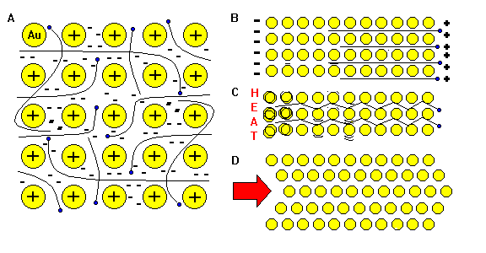
I/V curve for a light bulb
In the fixed resistor, current and voltage are directly proportional. But for a light bulb as the current increases, the electron/ion collisions causes the ions to vibrate more (the filament heats up). This increases electron/ion collisions even more and so the resistance of the filament increases every time the current increases.
Notes:
76
76

Slide 77
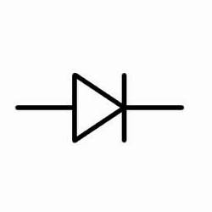
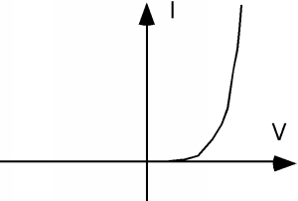
I/V curve for a diode
The arrow shows the direction of conventional current when the diode conducts.
Diodes only let current flow through them in one direction. They can be used to show that current is flowing in a circuit and in which direction.
Diodes are also used to change alternating current to direct current

Slide 78
Resistors in series and parallel
How does the total resistance of a circuit change if we connect:
More than one resistor in series?
More than one resistor in parallel?

Slide 79



Light Dependent Resistors
The resistance of an LDR decreases as the light intensity increases

Slide 80



Thermistors
The resistance of a thermistor decreases as the temperature increases

Slide 81
Voltage/current graphs
I
1
I
2
I
3
I
4
V
V
V
V
2
A. A filament lamp.
B. A diode.
C. Wires of different materials.
D. A metal resistor.
4
3
1

Slide 82
What does the circuit symbol shown represent?
Voltmeter
Variable resistor
Light dependent resistor
Thermistor
✓

Slide 83
Resistors in series
Total resistance = R₁ + R₂
4Ω
2Ω
What is the total resistance for the circuit shown?
Total resistance = R₁ + R₂
Total resistance = 4 Ω + 2 Ω
Total resistance = 6 Ω

Slide 84
Resistors in series
What is the total resistance for the circuit shown?
6Ω
34Ω
Total resistance = R₁ + R₂
Total resistance = 6 Ω + 34 Ω
Total resistance = 40 Ω

Slide 85
Resistors in parallel
If we connect resistors in parallel the total resistance of the circuit dcreases because there are more branches through which the current can flow.
4Ω
2Ω
Total resistance = R₁xR₂ R₁+ R₂
Total resistance = 4 x 2
4 + 2
= 1.33Ω
The total resistance is always smaller than the smallest resistor.

Slide 86
Resistors in parallel
What is the total resistance for the circuit shown?
8Ω
6Ω
Total resistance = 8 x 6
8 + 6
= 3.4Ω

Slide 87

Using conductive putty

Slide 88


Using copper tape

Slide 89

Using conductive paint

